Slide 1
Evidenced Based Medicine and the use of High Sensitivity Troponin T
Kim Wood MLS(ASCP)cm
Clinical Specialist – Core Lab
Roche Diagnostics

Slide 2
Learning Objectives
Review historical perspective of Troponin utilization
Understand the 4th universal definition of Myocardial Infarction (UDMI)
Comprehend the use of high sensitivity troponin in the chest pain patient

Slide 3
Evolution of Serial Troponin Testing
How We Have Progressed
Rule-out/Rule-in AMI
0h
1h
2h
3h
4h
5h
6h
7h
8h
9h
NACB 2007¹
cTn
2nd Universal 2007²
cTn
ESC 2011³
Hs-cTnT
4th Universal 2018⁴
cTn
ACC/AHA⁵
cTn
Elecsys pkg insert⁶
Hs-cTnT
TRAPID-AMI⁷
Hs-cTnT
1. National Academy of Clinical Biochemistry. 2007;
2. Thygesen K, et al. Eur Heart J. 2007;28:2525-2538;
3. Hamm CW, et al. Eur Heart J. 2011;32:2999-3054;
4. Thygesen K, et al. Circulation. 2018; EHJ (2018) 00, 1-33 5. Amsterdam EA, et al. Circulation. 2014;130:e344-e426;
6. Elecsys package insert;
7. Mueller C, et al. Ann Emerg Med. 2016;6876-87
Notes:
Conventional assay:
Time to rule out MI is between 8 hours and 12 hours
Requires admission to rule-out MI
hs-cTn assay:
Time to rule out MI is about 3 hours
Reduces ED resource utilization

Slide 4
IFCC Definition of High Sensitivity
The IFCC recommends using a troponin test that can measure the 99th percentile upper reference limit with an analytical imprecision ≤ 10 %
There is an international consensus that the 99th percentile upper reference limits should be reported as whole numbers in ng/L units.
The IFCC defines a high-sensitivity troponin test as one that can measure cTn above the Limit of Detection in ≥ 50% of healthy subjects.
Recommended Clinical Consideration
Sex-specific cut offs
Clinical Biochemistry (2015) 48 (4-5), 201-203
https://www.aacc.org/publications/cln/cln-stat/2015/april/16/ New-Guidance-on-High-sensitivity-Cardiac-Troponin-Testing
Notes:
ADD CVs here, too, by analyzer.
Add a table summarizing the analyzer specific data.

Slide 5
Higher Sensitivity of Next Gen Troponin
…could reveal submerged evidence of myocardial injury
AMI
PE
Myocarditis
Current
cTn
Next Gen cTn (ex. TnT Gen 5)
Myocardial injury
Other cardiac issues
Biomarkers results always must be interpreted in relation to the clinical context and never in isolation.
Notes:
Now clearly with the high NPV and the clinical sensitivity, high-sensitive TnT can help ED physicians efficiently diagnose chest pain patients and manage their resources because a Troponin negative is TRULY negative for AMI. However, the question is how do you balance the excellent clinical sensitivity with the specificity?
I’d like to remind that Troponin elevations, while associated with MI, are actually indicative of myocardial injury.
I’d like to use the example of an iceberg. There is the buildup of ice you see on the surface and there is the ice that is underneath the water surface. As we know from the case of the Titanic, ALL of the iceberg is something you need to watch for! With the next-generation, high-sensitive Troponins, a positive Troponin may not necessarily be indicative of AMI but can reveal the diagnostic pathways you as a clinician can take to manage the patient appropriately.

Slide 6
IFCC Definition of High Sensitivity
The IFCC defines a high-sensitivity troponin test as one that can measure cTn above the Limit of Detection in ≥50% of healthy subjects. In the hsTnT Gen 5 assay’s reported reference cohort:
35.0% of healthy subjects was measured with hsTnT levels above 5 ng/L (e411 LoD)
55.1% of healthy subjects was measured with hsTnT levels above 3 ng/L (e601/602 LoD)
The IFCC recommends using a troponin test that can measure the 99th percentile upper reference limit with an analytical imprecision ≤10 %. The hsTnT Gen 5 assay 99th percentile URLs are:
19 ng/L for both sexes (n = 1301), Total CV 6%, 3% (e411, e601/2, e801)
14 ng/L for females (n = 656), Total CV 8%, 4% (e411, e601/2 e801)
22 ng/L for males (n = 645), Total CV 5%, 3% (e411, e601/2 e801)
hsTnT Gen 5 meets the IFCC definition on the cobas e601/602 and e801
There is an international consensus that the 99th percentile upper reference limits should be reported as whole numbers in ng/L units.
Clinical Biochemistry (2015) 48 (4-5), 201-203
https://www.aacc.org/publications/cln/cln-stat/2015/april/16/ New-Guidance-on-High-sensitivity-Cardiac-Troponin-Testing
Notes:
ADD CVs here, too, by analyzer.
Add a table summarizing the analyzer specific data.

Slide 7
A Model for Interpreting Myocardial Infarction vs Injury
…Myocardial injury or infarction?
Elevated Cardiac Troponin Value(s) > 99th percentile URL
Troponin rise and/or fall
Troponin level stable
With acute ischemia
Without acute ischemia
Acute myocardial infarction
Acute myocardial injury
Chronic myocardial injury
Atherosclerosis + thrombosis
Oxygen supply and demand imbalance
Type 1 MI: triggers
Plaque rupture
Plaque erosion
Type 2 MI: examples
Severe hypertension
Sustained tachyarrhythmia
Examples
Acute heart failure
Myocarditis
Examples
Structural heart disease
Chronic kidney disease
Thygesen, K, et al: Fourth Universal Definition of Myocardial Infarction (2018) An Expert Consensus Document; EHJ (2018) 00, 1-33

Slide 8
Expect More “Elevated” Troponins
New integer values: 6-10,000+
99th URL normal (14 F, 22 M) (19 both sexes)
HS Troponin T level of “52” is considered significantly abnormal (~ 0.03 cTn)
Harmonizes with Gen 4 values around “100 ng/L” = 0.1ng/ml
Grey zone is the NEW capture of elevated values not possible with current troponin
0.01 ng/mL
0.03 ng/mL
0.1 ng/mL
0.3 ng/mL
4th Gen cTnT
5th Gen cTnT
~6ng/L
~30 ng/L
~52ng/L
~100 ng/L
~300 ng/L
KEY POINT
Move away from calling troponin “positive” or “negative” Start thinking of it as a continuous measure
Adapted from Christenson et al. (2017) JALM 1(5): 544-561. Christenson et al. (2017) JALM 1(5):544-561 Supplemental Figure 2
8
Notes:
KEY POINT: MOVE AWAY FROM CALLING TROPONIN “POSITIVE” OR “NEGATIVE”
START THINKING OF IT AS A CONTINUOUS MEASURE
52 is really 48.2
30 is 29.4
100 is 114

Slide 9
Cardiac Troponin
Cardiac Muscle Contraction Regulated by Troponin Complex
Troponin C
Calcium-binding subunit of the troponin complex
Troponin complex is made up of 3 protein subunits attached to tropomyosin on the actin filament.
Essential for the regulation of striated muscle contraction.
Calcium-mediated
Troponin T and I have different isoforms that are coded by separate genes in cardiac and in skeletal muscle.
Troponin I
Inhibitory protein modulating actin and myosin interaction
Troponin T
Binding protein attaching complex to tropomyosin
Morrow, DA. Cardiovascular Biomarkers, Pathophysiology and Disease
Management. Totowa, NJ: Humana Press; 2006:16.
Notes:
Troponin is a globular protein complex attached to tropomyosin on the actin filament of striated muscle, distributed at regular intervals. The three protein complex is essential for the regulation of
striated muscle contraction. Activation of the complex is calcium-mediated.
Troponin T and I have different isoforms that are coded by separate genes in cardiac and in skeletal muscle.
As a result of its high tissue-specificity, cardiac troponin (cTn) is a highly sensitive marker for myocardial damage.
The complex has three subunits:
Troponin C which binds calcium.
Troponin I which modulates actin and myosin interaction
Troponin T which binds the complex to the tropomyosin.
NOTE: The purple strand represents tropomyosin. The pink spheres represent actin.

Slide 10
TnI Assays Have Different Analytical Sensitivities
The multiplicity of assays for cTnI makes standardization of TnI results problematic
cTnI assays have different analytical sensitivities
Different cTnI assays measure different epitopes of TnI
cTnI assays have different 99th percentiles
TnI
In contrast, cTnT results can be directly compared from case to case and hospital to hospital and are comparable during serial testing
TnT
Jaffe AS, Babuin L, Apple FS. Biomarkers in Acute Cardiac Disease. J Am Coll Cardiol. 2006;48:1-11

Slide 11
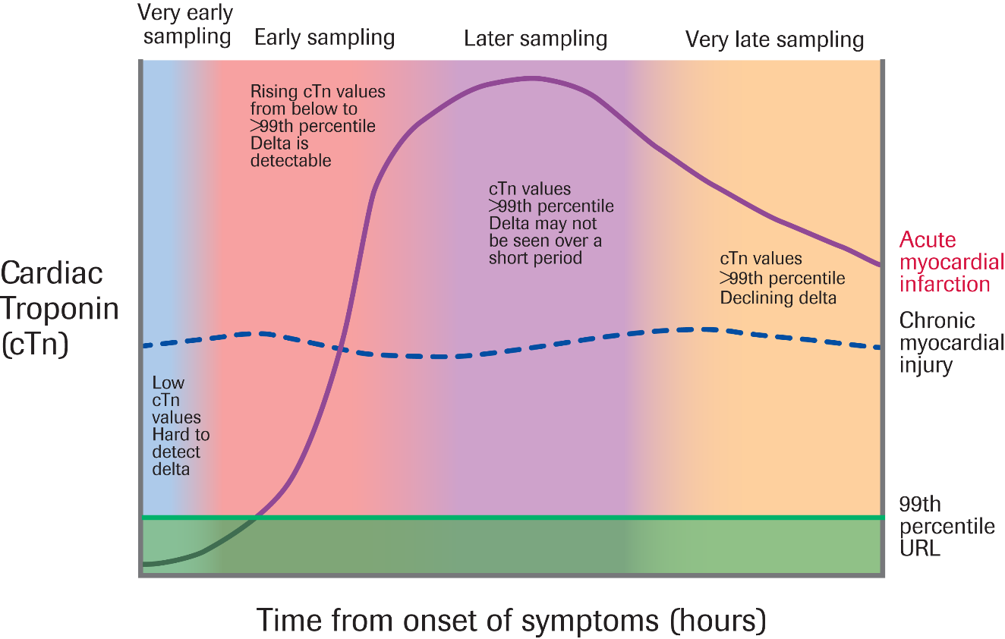
Troponin Kinetics in Myocardial Injury & Infarction
…What affects measurement?
Early troponin kinetics in patients after acute myocardial injury including acute MI
cTnT and cTnI are the preferred biomarkers to both rule in/rule out myocardial injury, and to define MI and subtype of MI
Detection of a rise and/or fall in cTn values is essential to differentiate acute injury from chronic injury
Criteria for determining a pathological rise between two serial troponin values are assay-specific and continue to evolve
Thygesen, K, et al: Fourth Universal Definition of Myocardial Infarction (2018) An Expert Consensus Document; EHJ (2018) 00, 1-33

Slide 12
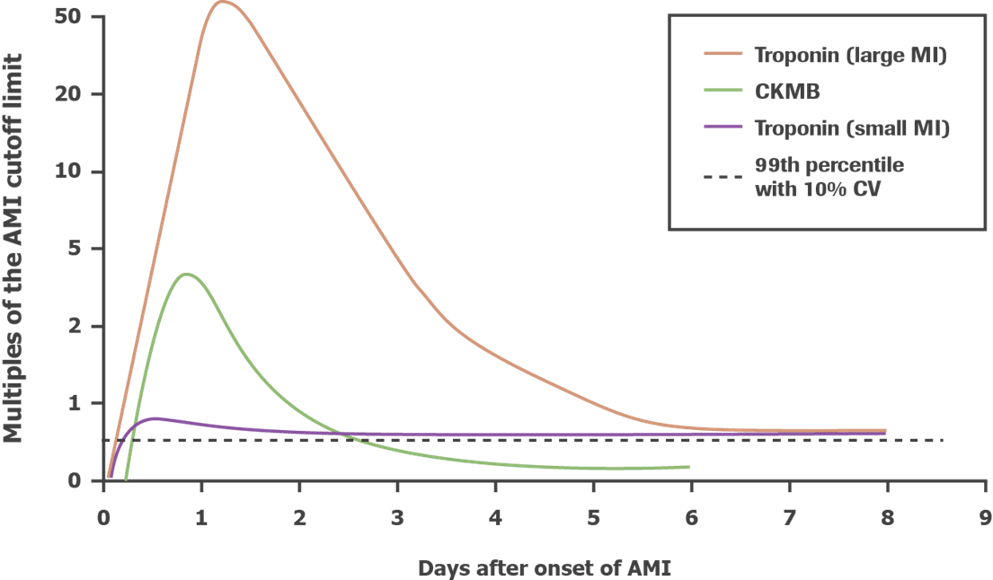
Interpretation of Troponin Levels
Kinetic Patterns of Cardiac Biomarkers: Rise and Fall
Release pattern of Troponin:
Peak during first 24 hrs
Subsequent fall to undetectable levels
Prolonged release lengthens diagnostic window:
Troponin T: 7 - 14 days
Troponin I: 7 - 10 days
French, J.K. and White, H.D., Heart 2004; 90:99-106 ( Illustration); Sodi R., Advances in Clinical Chemistry 2006; 41;49-122; Bertinchant JP et al. “Release kinetics of serum cardiac troponin I in ischemic myocardial injury”, Clin Biochem 1996; 29;587-594; Amsterdam, E., et al. 2014 AHA/ACC Guideline for the Management of Patients With Non-ST-Elevation Acute Coronary Syndromes.

Slide 13
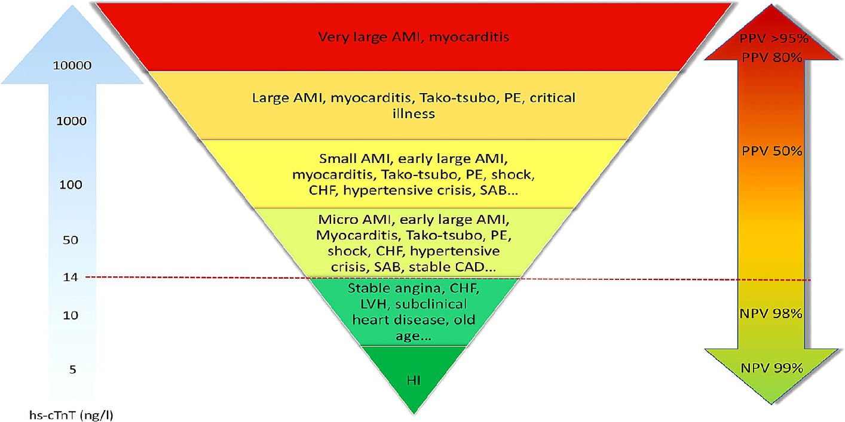
Quantitative Levels of TnT Gen 5
PPV = High Probability of AMI
10,000
1,000
Indeterminate =
Differentiated by value change
100
50
19
10
NPV = Low Probability
(low risk) for AMI
6
Healthy
Individual
TnT Gen 5
Adaptive chart from: Garg P. et al, Intern Emerg Med. 2017;12:147-155
13
Notes:
One Picture – I cannot make changes
Remove red dotted line
Change 5 to 6
Change 14 to 19
Changee hsTnT to TnT Gen 5
Once changes are made – notation should be – “adaptive from Garg, P. et al, Intern Emerg Med. 2017;12:147-155”

Slide 14
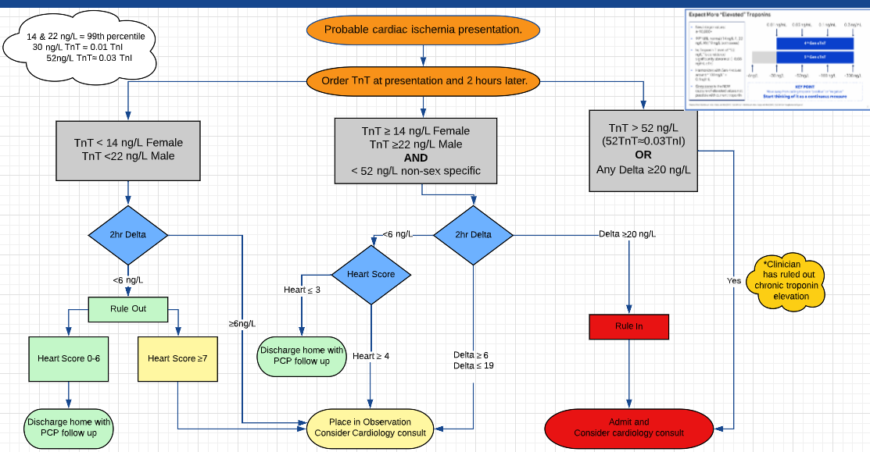

Slide 15
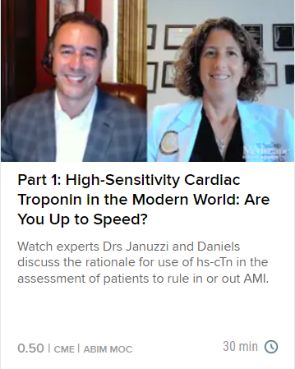
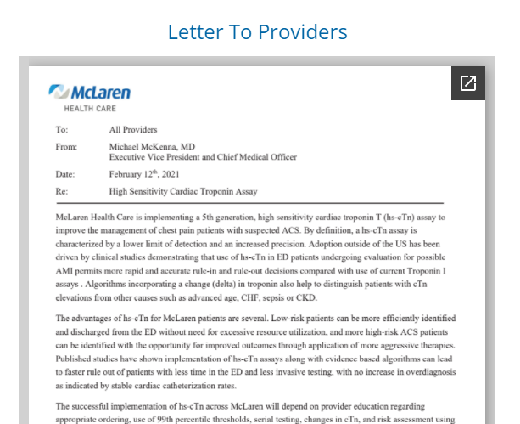
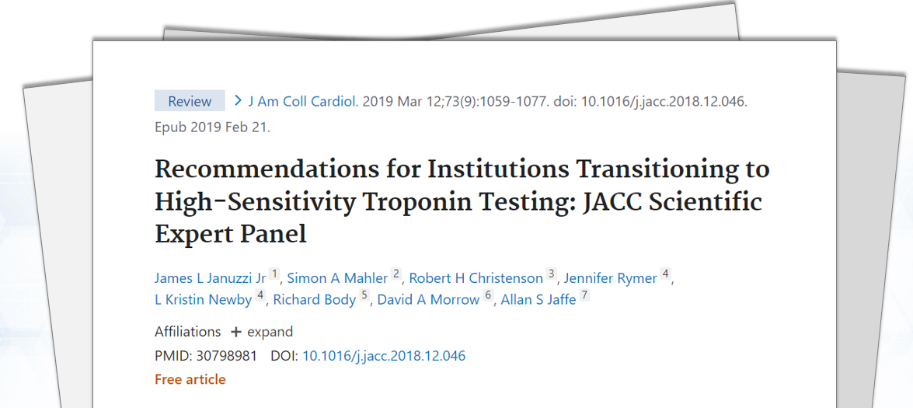
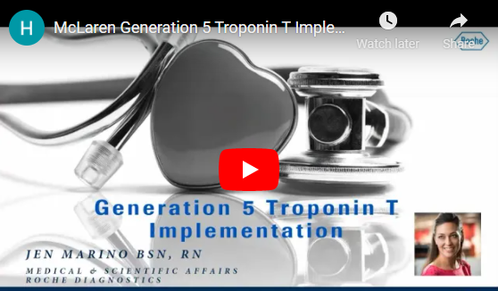
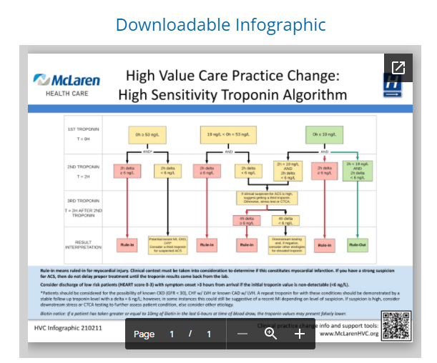
Educational Resources
Key Literature
General Education Videos
Medscape Program
Reference Resources
Educational Sessions
Best practices from real-world institutions
Specific patient populations of interest
<20 minute videos for on-demand learning
Three critical perspectives: Nursing, Clinicians, Laboratorians
From field experts, Dr. Januzzi & Dr. Daniels
Implementation- focus
Offers CE credits
2021 AHA/ACC Chest Pain Guidelines Summary
McLaren Health Landing Page
Roche Clinical Specialists & Scientific Liaisons
Host educational sessions
Host Q&A sessions post self-learning

