Slide 1
Sample Collection and Requirements
Blood Bank Testing

Slide 2

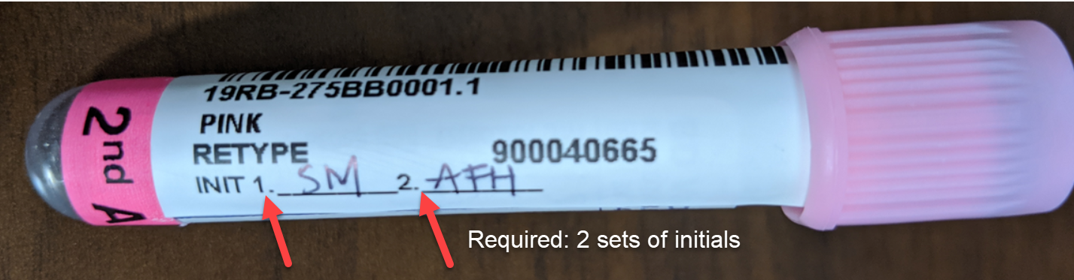
Blood Bank Testing
Sample Collection and Requirements
Positively identifying your patient and properly labeling the Blood Bank sample at the bedside is the first and most important step to assure a safe transfusion.
Prove that you verified the draw!
Two sets of legible initials must be on each tube of the Type and Screen tube(s) or specimen will need to be redrawn.

Slide 3
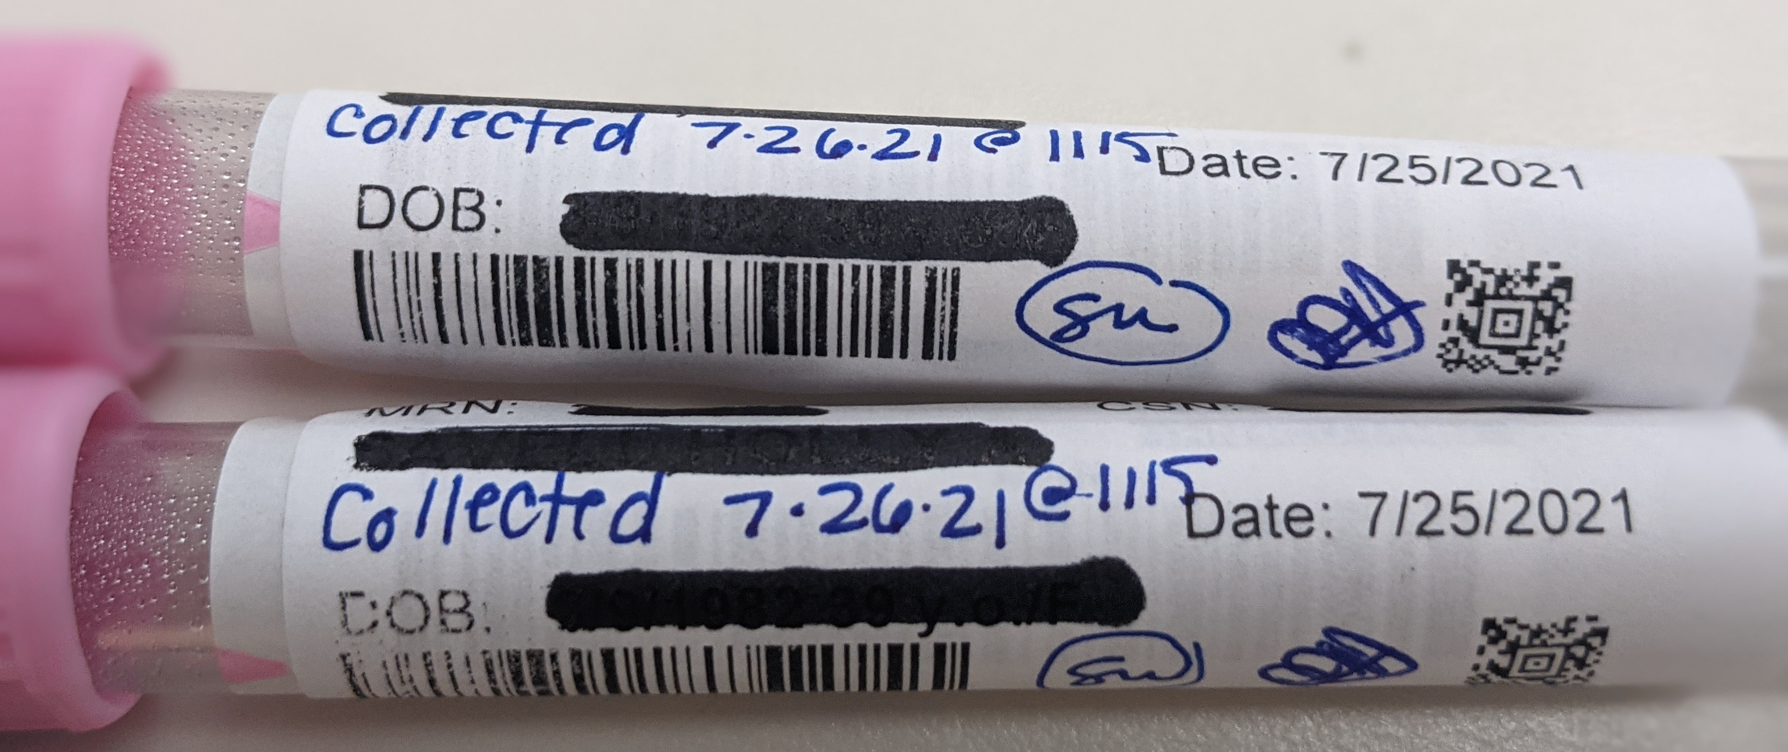
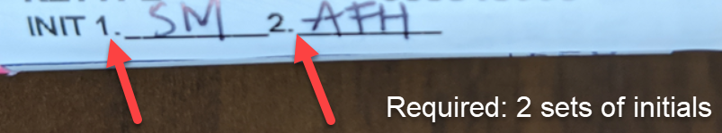

Bank Testing: Sample Collection and Requirements
Positively identifying your patient and properly labeling the Blood Bank sample at the bedside is the first and most important step to assure a safe transfusion.
The person who draws the sample and another healthcare provider must verify the identity of the patient at the bedside and initial the label
  Verify patient’s name at the bedside
    Compare hospital ID bracelet to the specimen (lab) label.
    While viewing ID bracelet, ask pt. to state his/her name and DOB & verify match.
  Info required on lab label:
    Patient’s first and last name
    Medical record number
    Draw date and time
    All of these are included on the Epic zebra label (the date is the Julian date in the accession number)
      The date and time must be written on the label if not recorded in EPIC (see example)
  Specimen collection
    One full pink top tube is needed for blood bank testing
      Short draws & grossly hemolyzed specimens are likely to be rejected. Invert tube 10 times to mix to avoid hemolysis.
    Label the sample with the lab label while still in the presence of the patient,
    IMMEDIATELY initial the tube(s) clearly
      Your initials PLUS
      The initials of the second-check in the room drawing with you
      Initials need to be on EVERY tube sent for pre-transfusion testing

Slide 4
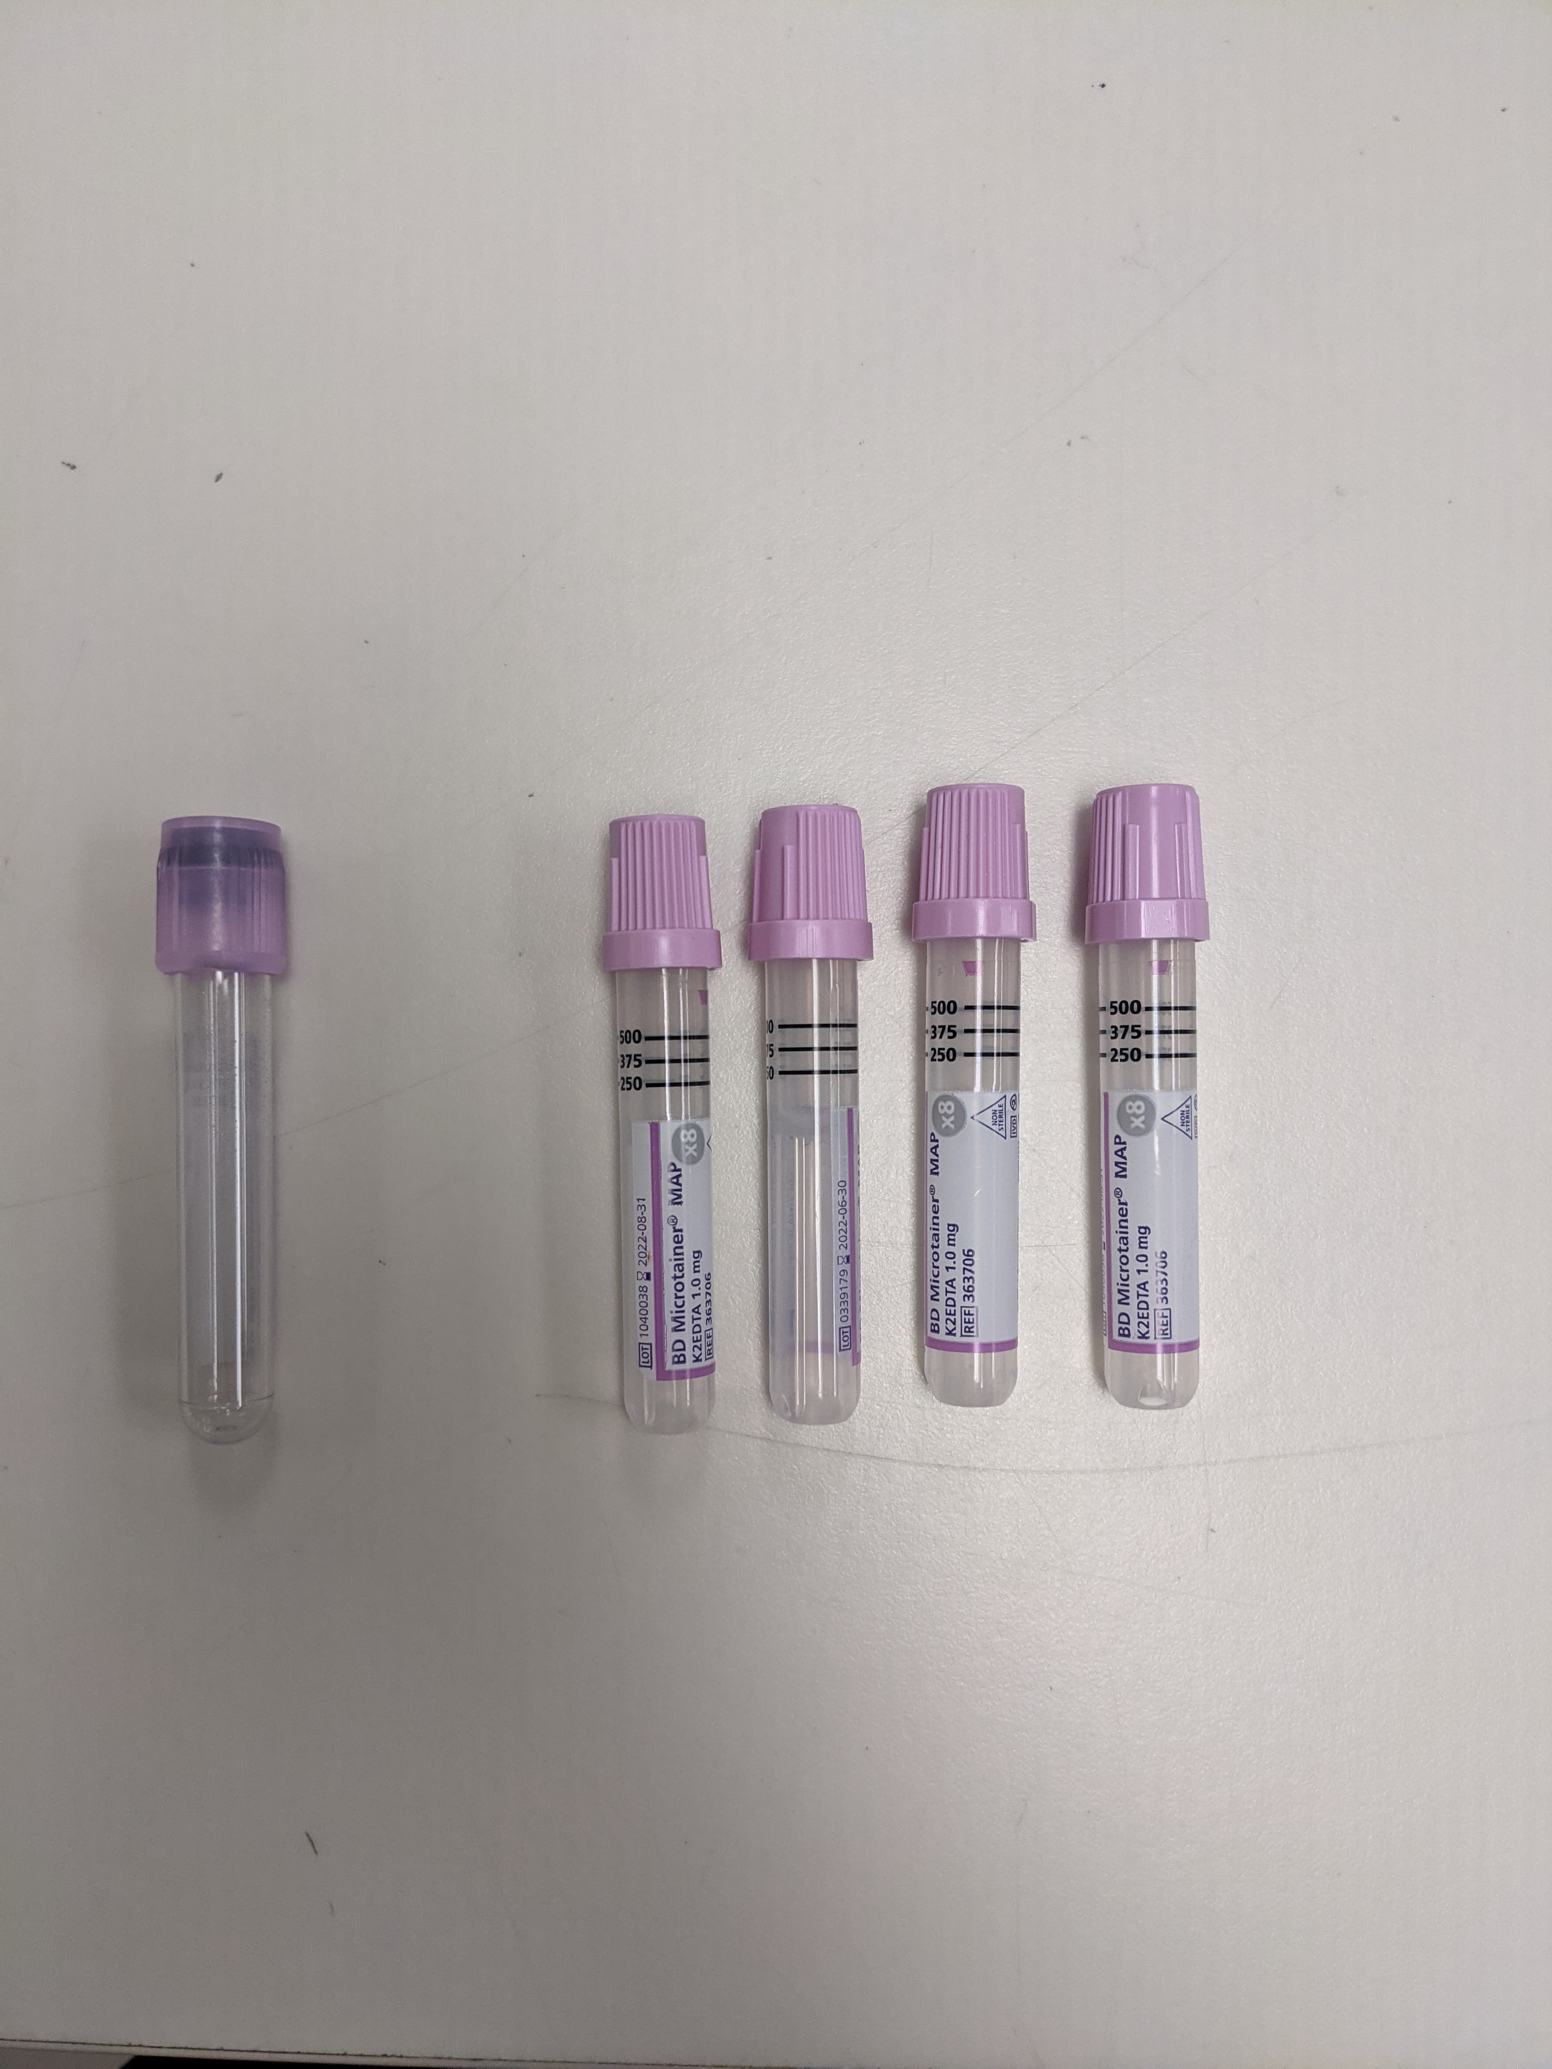
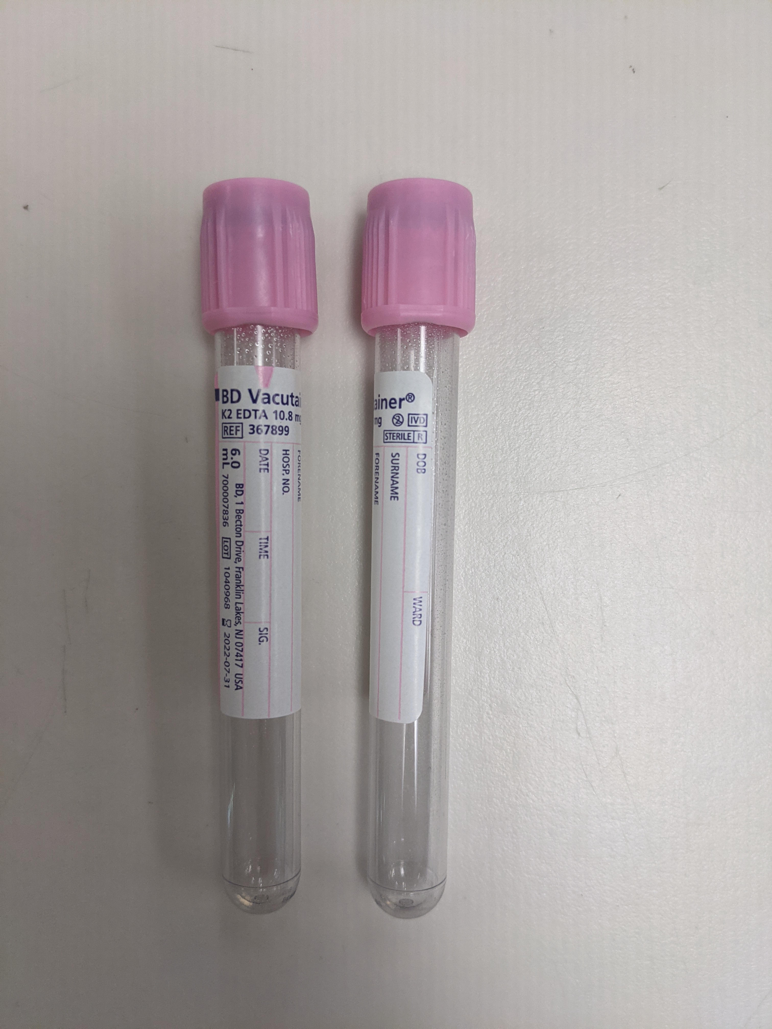
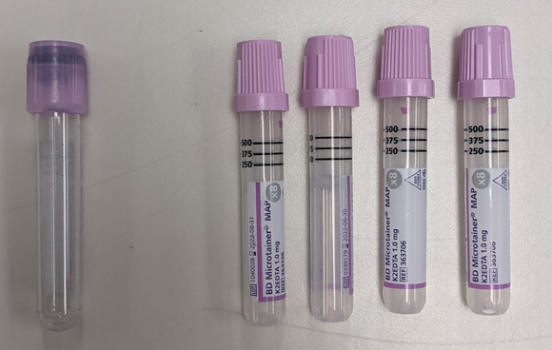
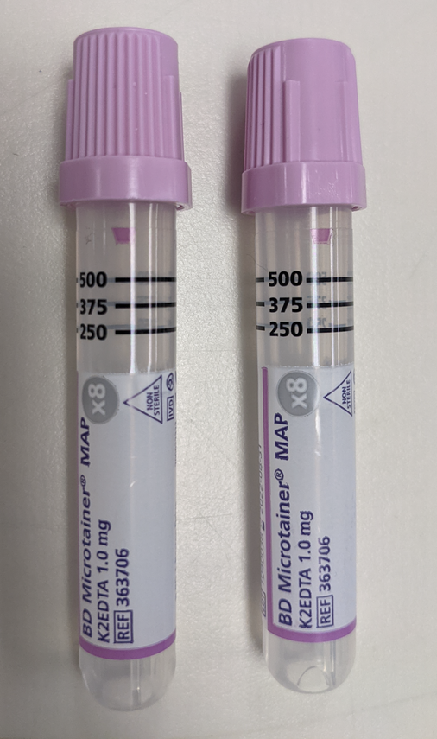
Preferred quantity for different draws
Adult >4 months pediatric Newborns
or
If the patient is a particularly difficult draw, please notify the blood bank at 719-364-1215 of potential issues to discuss minimum volumes and collection options. It is better to draw one full tube than two half filled tubes.

Slide 5

Blood Bank Testing: Sample Collection and Requirements
Why does the blood bank have such strict labeling requirements?
99% accuracy is not good enough, 1% is a SENTINEL EVENT
UCHealth transfused ~37,000 blood products last year. With 99% accuracy, 370 blood products (almost one per day) could have been a sentinel event.

Slide 6
Blood Bank Testing: Sample Collection and Requirements
If the patient is receiving ABO/Rh testing for the first time at a UCHealth facility, a retype sample is required.
  A retype is ABO/Rh testing repeated on a separate specimen to ensure the accuracy of results
    This sample must be from a new draw – DO NOT transfer blood from a previous draw.
    We are able to use a CBC tube if we have one from a separate collection
The patient must have two blood type specimens on record to receive products
    If a patient has two blood types done by our system, then products other than RBCs can be set up without current testing
    AABB Standard 5.14.5 requires a second sample for confirmation of the ABO and Rh types prior to issuing blood to a patient being transfused for the first time in their facility.

Slide 7

Blood Bank Testing: Sample Collection and Requirements
Why is a second sample required at UCHealth facilities for a retype? Risk of WBIT!
  WBIT (Wrong Blood In Tube) is when the tube says it is patient A’s blood, but it actually contains blood from patient B.
    A study (AJCP 2006;126(3):422-426) stated this risk to be approximately 1 in 2000 specimens.
WBIT is a problem because the safe testing protocols available will not protect a patient when the wrong blood is in a tube with their name on it.
    Blood banks always check previous records to make sure that the current ABO and Rh testing agrees with what was seen previously, so WBIT is usually discovered prior to transfusion in patients with previous records.
    There is high risk when WBIT occurs on patients who are being transfused for the first time (with no previous records to check).
Retypes protect patients! Thank you for taking the extra step for patient safety.

