Slide 1
Specimen Submission – Routine Pathology
No Fix or In Formalin – How to choose?
Formalin Fixation cannot be used for specimens that require special studies and therefore must be sent fresh
Lymphoma protocol, Gout Analysis, Cytogenetics, Cultures
If there are no special studies that prevent the use of formalin fixation and no specific request to send the tissue specimen fresh, then the choice comes down to containers available
Is there a pre-filled formalin container that would allow for proper fixation?
Remember - the ratio of formalin to tissue should be 1:9 by volume allowing the specimen to be free-floating and relatively submerged
Yes – place tissue into pre-filled formalin container and deliver to the lab
No – select an empty container. The specimen must fit reasonably in the container with ample room for formalin addition and the container lid must seal. Place tissue into the empty container and send STAT to the lab with verbal notification of delivery.
When in doubt, send it fresh

Slide 2
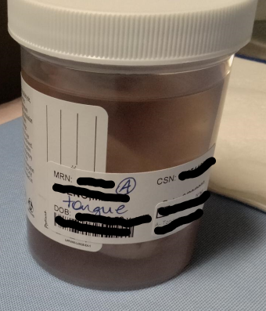
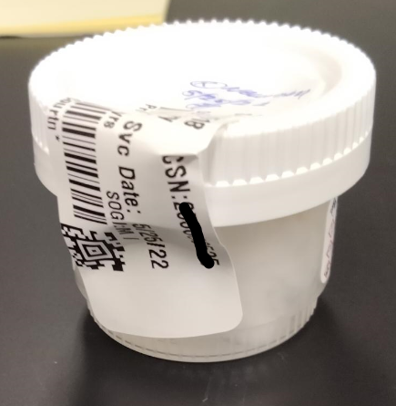
Container – Patient and Specimen Information
Labeling must be on the container – not the lid
This is a requirement of our accrediting agencies
Lids can be switched easily
Two Patient Identifiers at minimum:
Name (Last, First) and DOB *or* Name (Last, First) and MRN
Specimen Site: MUST match what is on the requisition exactly
Notes:
Can use (R) or (L) as abbreviations for Right and Left respectively, if other abbreviations are needed for common use, it must be discussed with Pathology before using
If there are two things from the same site, it must be indicated as #1 (site matching requisition) on one container and #2 (site matching requisition) on the other container
When writing on the container use permanent ink or pencil ONLY

Slide 3
Key Members of the Pathology Staff and Contacts
Courtney B., Julissa S., Alex E., Gabriela K. – Lab Technicians
Receive specimens, verify requisitions and specimen labeling are correct, and accession into our Information System.
Responsible for resolving items/issues identified during receiving or by the PAs and are usually the people that will follow up with submitting staff
Tia B. – Lead PA, Jessi H. – PA, Kelly H.- PA
The PAs receive specimens that have been accessioned and are ready for grossing They review the specimen container and requisition for accuracy and document this in our Information System.
The PAs may also follow up directly with submitting staff
Elizabeth M. – Pathology Lab Manager
Elizabeth.Menendez@uchealth.org
Gross Room
Hours 8am- 4pm
Phone: 720-516-2096
When in doubt about ordering or test routing, contact the Pathology lab and keep the tissue fresh

Slide 4
Surgical Specimen for Pathology Submission
Intra-Operative Consultation
Frozen Section
Gross Margins
Breast
Lymphoma
POC
Gout (Tissue)
Routine Pathology
Routine Pathology
No Fix
No Fix
No Fix
No Fix
No Fix
No Fix
No Fix
Formalin
Deliver ASAP
Must deliver
within 30 min
Verbal Notification required at delivery (Face to Face or Call)
Deliver to:
Monday – Friday 8am – 4pm: Gross Room
Off Hours and Weekends: Clinical Lab

