Slide 1
Specimen Submission – Cultures
Tissue Specimens for cultures
Formalin kills bacteria and fungus, so the specimen must be sent fresh.
Specimen must be collected in a sterile manner and placed in a sterile container.
Submission for Cultures
Tissue must be selected and placed in a sterile container in the OR.
Pathology is not sterile and Pathology staff cannot select or submit tissue from a larger piece.
The orders must be submitted as a CLINICAL lab test by the OR staff in the Specimen Order screen
For specific collection or ordering questions, call the Microbiology Lab at 720-848-7084
Cultures may be done on TISSUE but they are NOT PATHOLOGY tests
Do NOT refrigerate

Slide 2
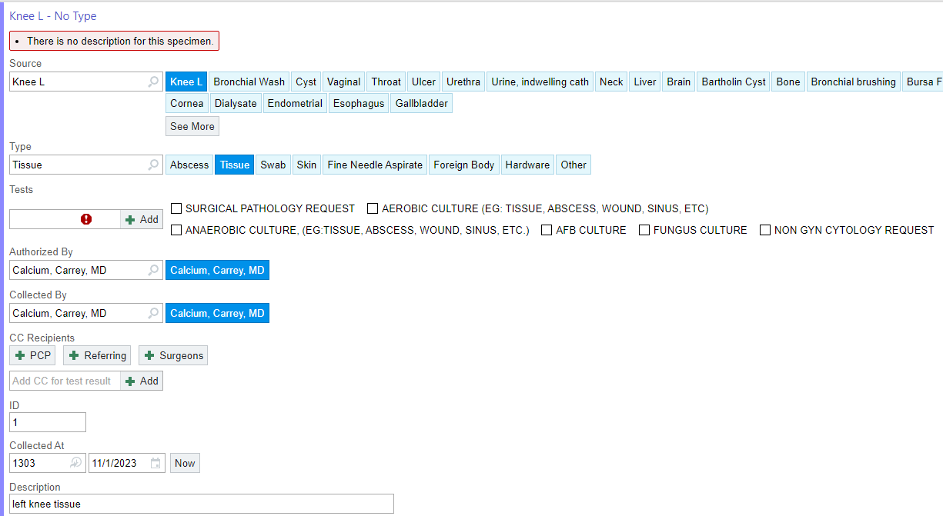
Specimen Submission – Cultures
Example: Tissue Culture Order
Select source
Select Type - TISSUE
Select desired test (note – surgical pathology is automatically selected and must be deselected for the specimen being sent for cultures)
For specific collection or ordering questions, call the Microbiology Lab at 720-848-7084

