Slide 1
Specimen Submission – Paps
Submission for Pap
The orders must be submitted as Cervical Vaginal Cytology Request in the regular order screen, not specimen orders, most of the specimen type and source autopopulates.
Specimen Type will be Pap Test
Specimen Source will be Cervix, Endocervial
Answer questions, may need to clarify request with physician
Paps are sent to AMC for evaluation
OR must order Paps the same way as clinics as there is no way to order using the same information and testing in Specimen Navigator

Slide 2
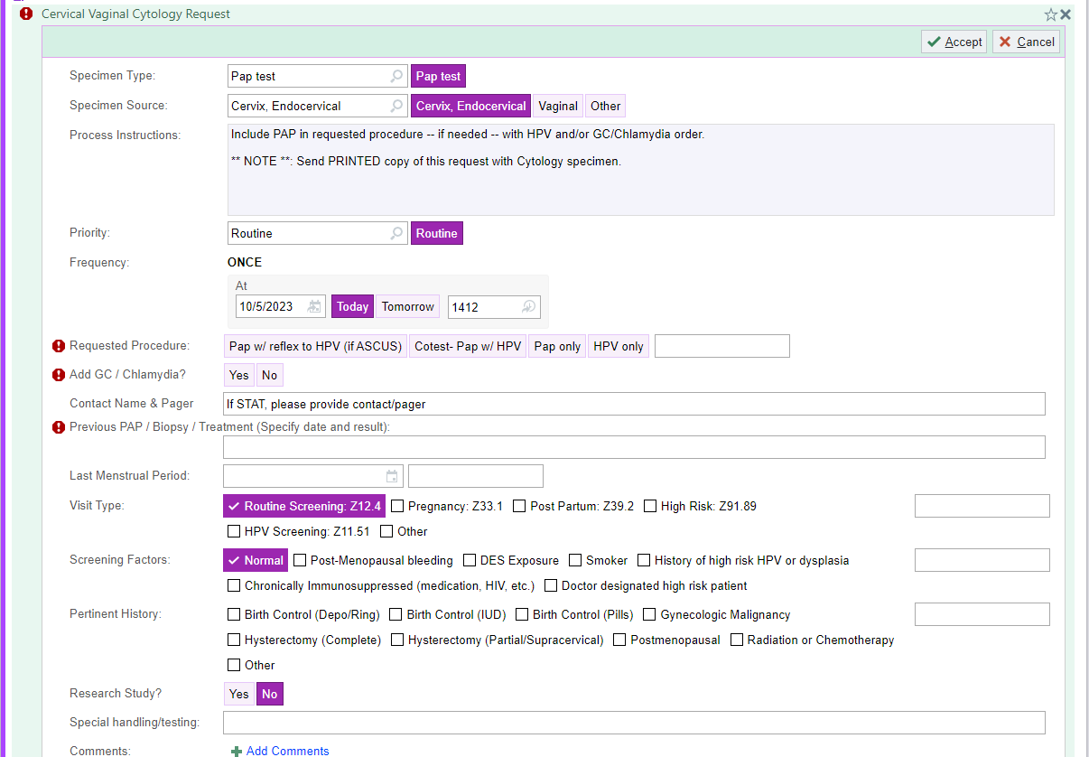
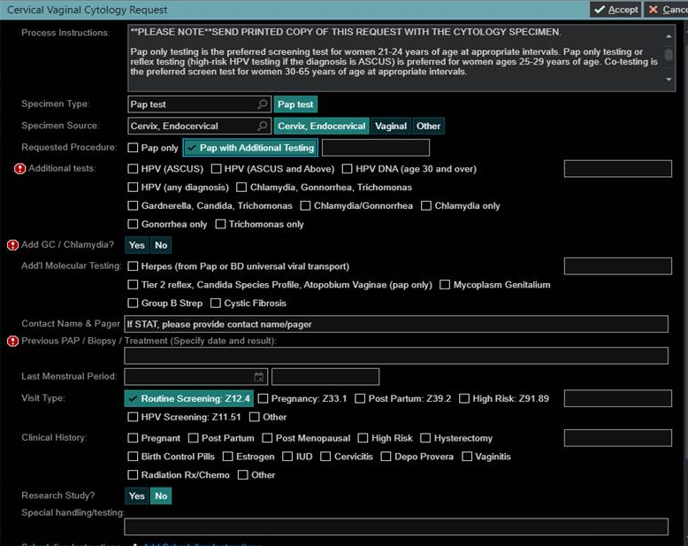
Specimen Submission – Paps
Example: Pap Order
Note – if order screen looks like the one on the right, for reflex to HPV testing select HPV (ASCUS and Above)

