Slide 1
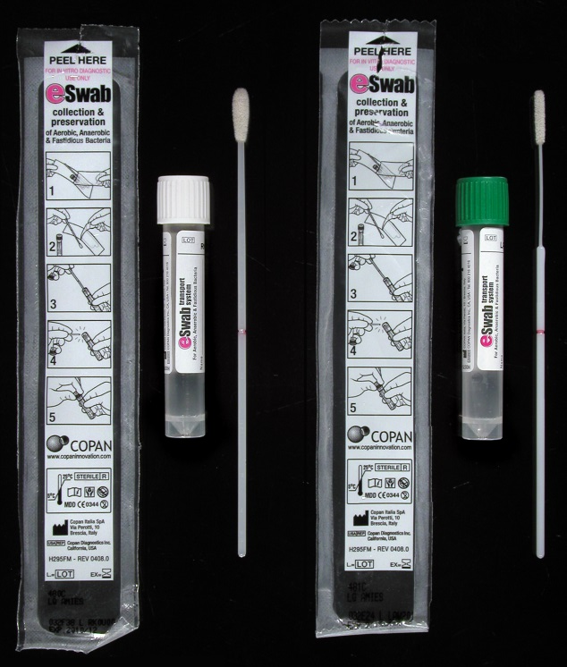
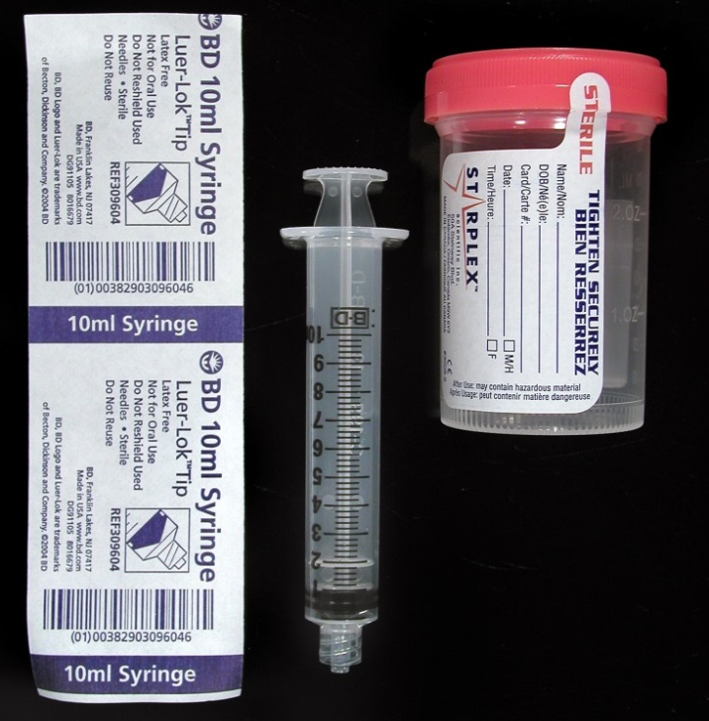
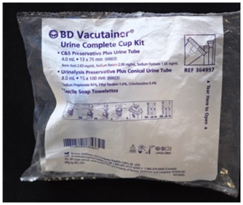
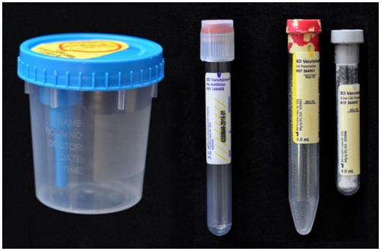
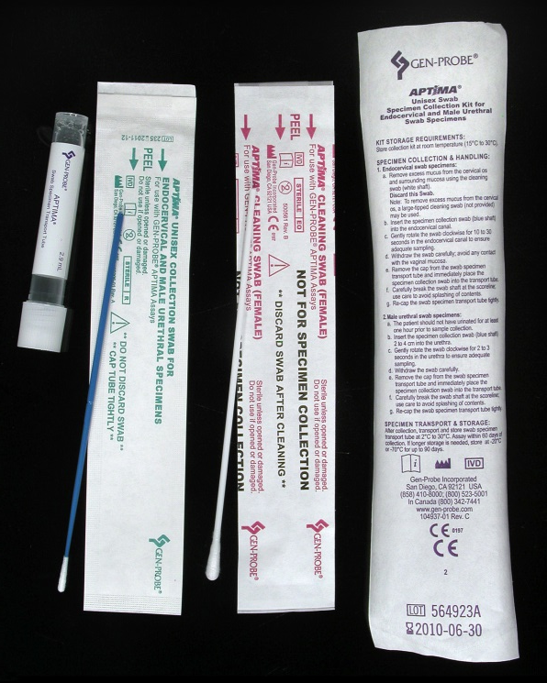
The Right Swab for the Job
Microbiology Testing (Bacteria/Fungus):
BEST option for aerobic, anaerobic and fungal cultures:
Unpreserved, direct specimen in sterile container.
When a swab must be used: use eSwab!
Multiplex Vaginal Panel PCR
Collect vaginal fluid using a Cepheid Xpert Swab Collection kit.
Discard large swab in package. Collect using pink capped tube and small swab. Place the swab in the tube. Break swab shaft at score line, close cap firmly.
No. 397882 Xpert SwabSpecimen Cllection Kit
No. 55147 eSwab with Transport Media, small tip (green top)
No. 10917 eSwab with Transport Media (white top)
Use these when a swab must be used for bacterial or yeast cultures and screens and Group B Strep.
Examples: throat, rectal, wound, nares/axilla/groin for MRSA screening.
Use for aerobic or anaerobic bacterial or yeast culture. DO NOT use for mold (fungal) or AFB culture.
Group A Strep PCR
E-swab of posterior pharynx, tonsillar area.
Avoid touching the tongue, cheeks, and teeth with the swab when collecting the specimen.
Sterile Cup/Sterile Syringe
BEST for culture if the specimen can be expressed or tissue can be collected. Use these for tissue, body fluids, pus, or drains. Can do fungal and/or AFB cultures on these specimens.
If using syringe, remove the needle and securely cap before transport (white screw top preferred).
No. 10917 eSwab with Transport Media (white top)
After sample collection, break off shaft at red indicator line, put swab in the provided media tube and screw cap on.
Molecular Viral Testing:
Molecular Testing (Genprobe PCR only):
Urine Testing:
Direct specimen
(2 mL minimum or swab in M6 media)
No. 364957 BD Vacutainer Urine Cup Kit
Use Urine Cup to collect specimens. Transfer urine to appropriate tubes. Discard urine cup – DO NOT SEND TO LAB.
SEND ALL THREE! (for possible add-on tests):
Clear Top Tube (not included in kit) Urine pregnancy, urine chemistries, urine toxicology and miscellaneous sendouts – Refer to online test catalog for minimum volumes.
Red/Yellow Speckled Top Urinalysis only, minimum volume 7mL (mix by inversion 8-10 times).
Urine cultures: Gray top tube, minimum volume 3mL (mix by inversion 8-10 times).
Sterile Cup (no syringe)
Can be used for straight specimen or tissue.
No. 59024 Sterile Swab Applicator Tip flocked with nylon fiber
No. 63252 Sterile Swab Applicator Tip flocked with nylon fiber, nasopharyngeal,
And No. 64758 M6 Transport Media
Swabs for viral testing MUST be sent in M6 media.
Examples: Influenza A/B Qualitative by PCR, RSV Qualitative by PCR
No. 46871 Gen-Probe Aptima Unisex Swab
For GC/chlamydia and Trichomonas PCR.
See lab test catalog for correct blood tube or container for other PCR testing.
Revised 03/2019
UCHealth Highlands Ranch Hospital Laboratory – Questions?
Visit https://www.testmenu.com/UCHealthHRHLab, or call:
Laboratory: 720-516-0190

