Slide 1
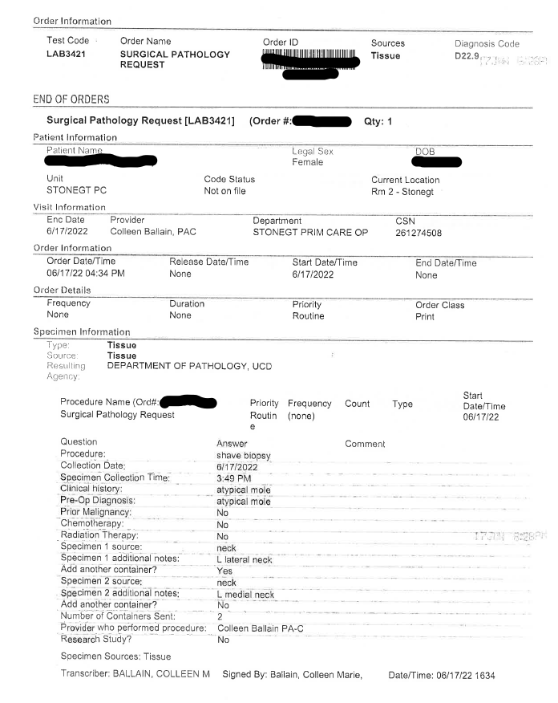
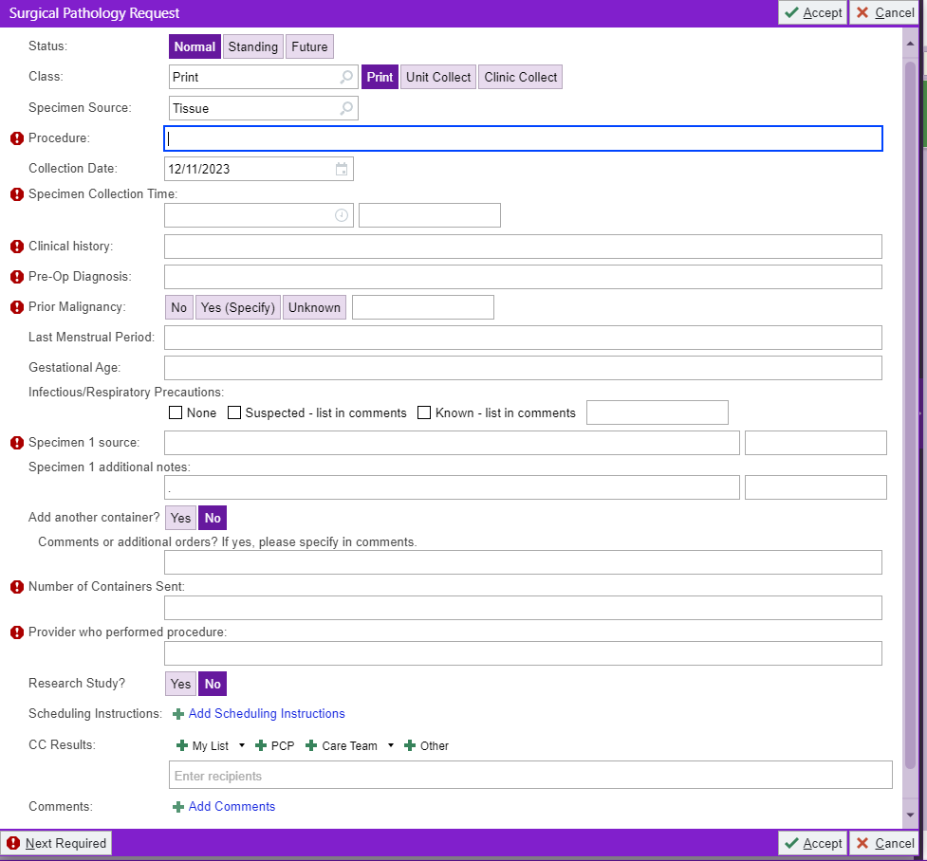
Pathology Order Entry

Slide 2
Pathology Order Entry
Example: Two specimens/containers
Each is in its own container, so there will need to be two specimens entered, even if they are from the same site.
Under additional notes, the site must be written and must match the site given on the label of the container
Number of containers must be entered and accurately reflect the number of containers sent
neck
L lateral neck
neck
L medial neck

Slide 3
Requisition
After Patient Demographics – Most Important Elements
History/Pre-Op Dx: This tells the Pathologists’ Assistant why the patient is there and any additional relevant information so they can accurately assess the specimen at grossing
Specimen Source: This is the specimen sent and must be entered for every container
Site: Entered under additional notes and is the specific location, must match the location written on the specimen
Number of containers/sites: make sure it matches the number of containers sent

Slide 4
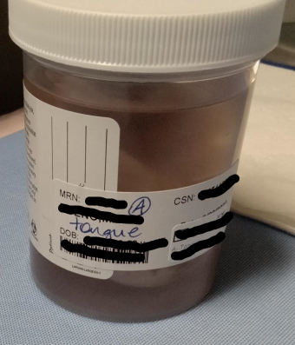
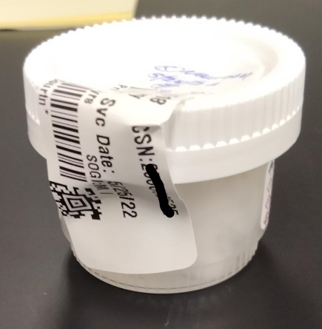
Container – Patient and Specimen Information
Labeling must be on the container – not the lid
This is a requirement of our accrediting agencies
Lids can be switched easily
Two Patient Identifiers at minimum:
Name (Last, First) and DOB *or* Name (Last, First) and MRN
Specimen Site: MUST match what is on the requisition exactly
Notes:
Can use (R) or (L) as abbreviations for Right and Left respectively, if other abbreviations are needed for common use, it must be discussed with Pathology before using
If there are two things from the same site, it must be indicated as #1 (site matching requisition) on one container and #2 (site matching requisition) on the other container
When writing on the container use permanent ink or pencil ONLY

Slide 5
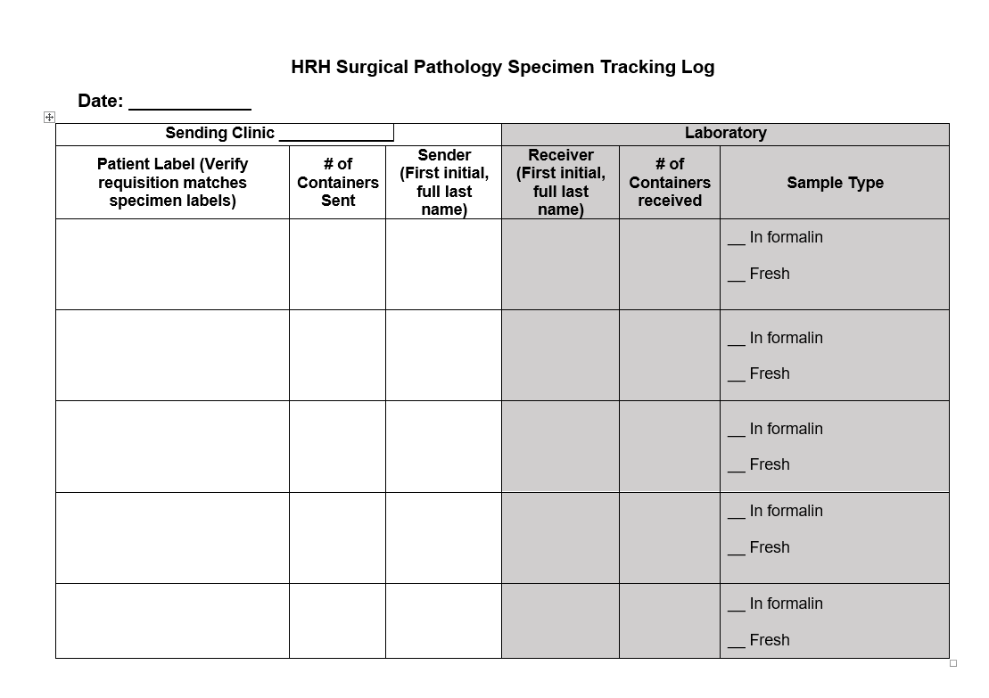
Pathology Specimen Log
The Log must be filled out completely
Patient information must match the requisition and container exactly
Log is how Pathology ensures all specimens sent are received
A separate log must be used for every separate delivery of specimens
Suggested that a copy is retained for your records in the event specimens are not received
Note: Specimens submitted in saline soaked gauze are considered fresh

Slide 6
Key Members of the Pathology Staff and Contacts
Courtney B., Julissa S., Alex E., Gabriela K. – Lab Technicians
Receive specimens, verify requisitions and specimen labeling are correct, and accession into our Information System.
Responsible for resolving items/issues identified during receiving or by the PAs and are usually the people that will follow up with submitting staff
Tia B. – Lead PA, Jessi H. – PA, Kelly H.- PA
The PAs receive specimens that have been accessioned and are ready for grossing They review the specimen container and requisition for accuracy and document this in our Information System.
The PAs may also follow up directly with submitting staff
Elizabeth M. – Pathology Lab Manager
Elizabeth.Menendez@uchealth.org
Gross Room
Hours 8am- 4pm
Phone: 720-516-2096
When in doubt about ordering or test routing, contact the Pathology lab and keep the tissue fresh

