Slide 1
Specimen Submission – Gout Analysis
How is the specimen prepared for Gout analysis?
Tissue
A gross examination is performed to identify any grossly visible areas consistent with uric crystal accumulation, characterized by white chalky appearance.
If grossly identified, samples of the chalky material will be placed on a slide for Pathologist evaluation
If no areas of interest are grossly identified, a smear of the tissue will be made on the slide for Pathologists evaluation
Fluid
A drop of fluid is placed on a slide and a smear is made from the fluid for Pathologist evaluation
How is a slide analyzed for Gout?
The Pathologist will use special filters on the microscope to polarize the light. Gout crystals appear as yellow, needle-shaped crystals
This analysis also differentiates gout from pseudo-gout. Psuedo-gout is calcium crystals which appear more rhomboid in shape and has a different birefringence

Slide 2
Specimen Submission – Gout Analysis
Gout crystals are made of water soluble uric acid
If the specimen – tissue or fluid – come in contact with an aqueous solution, such as formalin, the gout crystals will be dissolved out.
Tissue for Gout Analysis – usually synovium
Tissue must be and placed in an empty container.
The tissue must be sent fresh for crystal analysis
Send with stat courier
Gout Protocol Order
Enter as a Surgical Pathology Request
Under “non-frozen attributes” select “Fresh with Special Studies” and select other
“r/o Gout” or “gout analysis” and joint location must be added to the description
Crystal analysis test as a selection is not available for tissue and must be written in the description
For specific collection or ordering questions, call the gross room at 720-516-2096

Slide 3
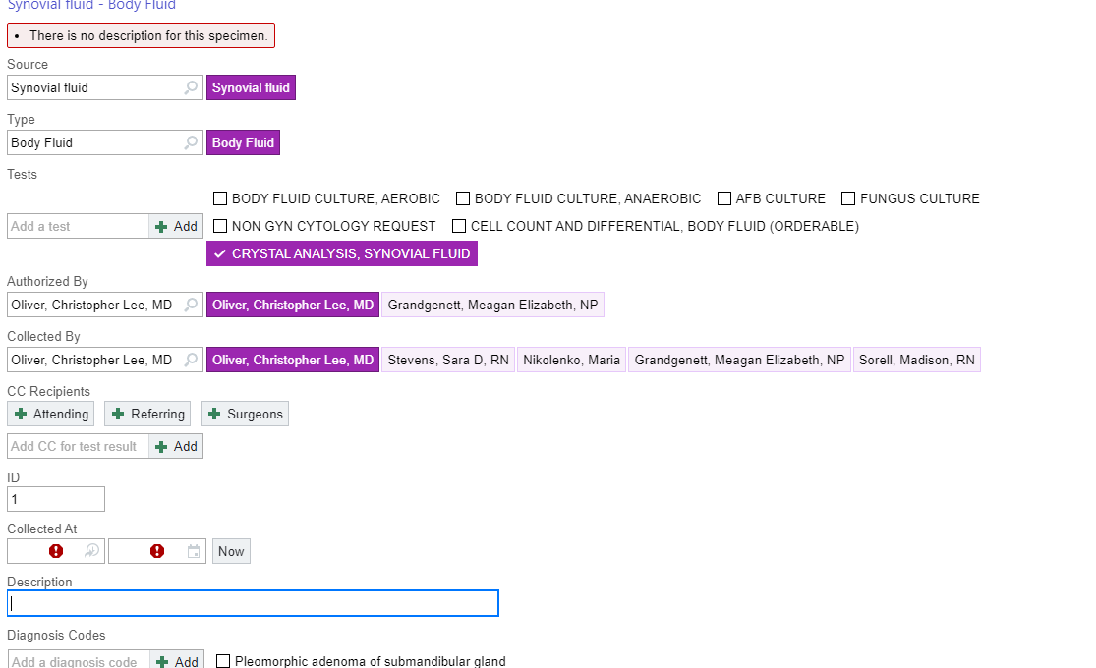
Specimen Submission – Gout Analysis
Gout crystals are made of water soluble uric acid
If the specimen – tissue or fluid – come in contact with an aqueous solution, such as formalin, the gout crystals will be dissolved out.
Fluid for Gout Analysis – synovial fluid
The orders must be submitted as a CLINICAL lab test by the OR staff in the Specimen Order screen
Fluid must be in original syringe (min volume 0.5mL) or in a green top tube (min volume 3mL)
For specific collection or ordering questions, call the Clinical Lab at 720-516-0190
Example: Fluid Gout Order
Select source – Synovial Fluid
Select Type – Body Fluid
Select desired test

Slide 4
Key Members of the Pathology Staff and Contacts
Courtney B., Julissa S., Alex E., Gabriela K. – Lab Technicians
Receive specimens, verify requisitions and specimen labeling are correct, and accession into our Information System.
Responsible for resolving items/issues identified during receiving or by the PAs and are usually the people that will follow up with submitting staff
Tia B. – Lead PA, Jessi H., Kelly H.- PA
The PAs receive specimens that have been accessioned and are ready for grossing They review the specimen container and requisition for accuracy and document this in our Information System.
The PAs may also follow up directly with submitting staff
Elizabeth M. – Pathology Lab Manager
Elizabeth.Menendez@uchealth.org
Gross Room
Hours 8am- 4pm
Phone: 720-516-2096
When in doubt about ordering or test routing, contact the Pathology lab and keep the tissue fresh

