Slide 1
Key Members of the Pathology Staff and Contacts
Courtney B., Julissa S., Alex E., Gabriela K. – Lab Technicians
Receive specimens, verify requisitions and specimen labeling are correct, and accession into our Information System.
Responsible for resolving items/issues identified during receiving or by the PAs and are usually the people that will follow up with submitting staff
Tia B. – Lead PA, Jessi H. - PA, Kelly H.- PA
The PAs receive specimens that have been accessioned and are ready for grossing They review the specimen container and requisition for accuracy and document this in our Information System.
The PAs may also follow up directly with submitting staff
Elizabeth M. – Pathology Lab Manager
Elizabeth.Menendez@uchealth.org
Gross Room
Hours 8am- 4pm
Phone: 720-516-2096
When in doubt about ordering or test routing, contact the Pathology lab and keep the tissue fresh

Slide 2
Surgical Specimen for Pathology Submission
Intra-Operative Consultation
Frozen Section
Gross Margins
Breast
Lymphoma
POC
Gout (Tissue)
Routine Pathology
Routine Pathology
No Fix
No Fix
No Fix
No Fix
No Fix
No Fix
No Fix
Formalin
Deliver ASAP
Must deliver
within 30 min
Verbal Notification required at delivery (Face to Face or Call)
Deliver to:
Monday – Friday 8am – 4pm: Gross Room
Off Hours and Weekends: Clinical Lab

Slide 3
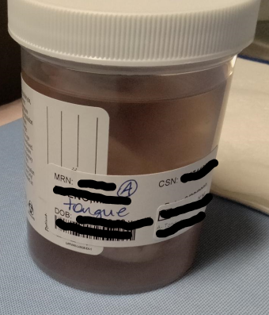
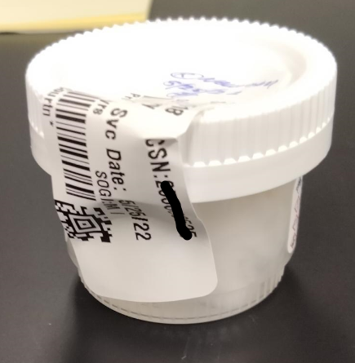
Container – Patient and Specimen Information
Labeling must be on the container – not the lid
This is a requirement of our accrediting agencies
Lids can be switched easily
Two Patient Identifiers at minimum:
Name (Last, First) and DOB *or* Name (Last, First) and MRN
Specimen Site: MUST match what is on the requisition exactly
Notes:
Can use (R) or (L) as abbreviations for Right and Left respectively, if other abbreviations are needed for common use, it must be discussed with Pathology before using
If there are two things from the same site, it must be indicated as #1 (site matching requisition) on one container and #2 (site matching requisition) on the other container
When writing on the container use permanent ink or pencil ONLY

Slide 4
Specimen Submission – Frozen Section
Specimens for Frozen Sections
Specimen is sent for intraoperative consultation to determine microscopically (frozen sections) how far the tumor or lesion is from the surgical margin.
Submission for Frozen Sections
Tissue must be fresh and placed in an empty container.
Frozen Section protocol Order
Enter as a Surgical Pathology Request
Select “Frozen” – “YES”
For specific collection or ordering questions, call the gross room at 720-516-2096

Slide 5
Specimen Submission – Gross Margins
Specimens for Gross Margins
Specimen is sent for intraoperative consultation to determine macroscopically (looking at the specimen) how far the tumor or lesion is from the surgical margin.
Submission for Gross Margins
Tissue must be fresh and placed in an empty container.
Gross Margin protocol Order
Enter as a Surgical Pathology Request
Under “non-frozen attributes” select “Fresh with Special Studies” and select “Gross Margin”
For specific collection or ordering questions, call the gross room at 720-516-2096

Slide 6
Specimen Submission – Breast
Breast Specimen
Breast specimens have a fixation time requirement – the specimen must be in formalin within 60 minutes of removal.
Must be delivered to Pathology within 30 minutes to allow for the PA to triage, ink, and open to allow for the formalin to reach the tumor or lesion
Submission
Large tissue specimens must be fresh and placed in an empty container.
Biopsies may be placed directly into formalin.
Breast Protocol Order
Enter as a Surgical Pathology Request
Under “non-frozen attributes” select “Fresh with Special Studies” and select “Breast”
The time of removal and the time in formalin must be accurately recorded to ensure regulatory compliance
For specific collection or ordering questions, call the gross room at 720-516-2096

Slide 7
Specimen Submission – Breast
Special Circumstances – Breast for non-cancer surgeries
ONLY for routine reductions and Gender Affirmation Surgeries
Collection time/time out of body is still required in case cancer is incidentally discovered
Breast Protocol Order
Only required to make one specimen per breast (i.e.: Specimen A – Right Breast; Specimen B – Left Breast)
Enter as a Surgical Pathology Request
Under “non-frozen attributes” select “Fresh with Special Studies” and select “Breast”
The time of removal and the time in formalin must be accurately recorded to ensure regulatory compliance
Note: If there is an unexpected finding (i.e.: an unexpected lesion is found during the reduction and a sample is taken for evaluation) a separate, new specimen must be generated.

Slide 8
Specimen Submission – Breast
Special Circumstances – Breast for non-cancer surgeries Cont.
Specimen Submission
The OR will drop the first bucket to Pathology and must let the lab staff know that additional buckets will be delivered for specimen A and/or B
The collection time on the requisition will reflect the initial collection time for the first piece in the first bucket.
Each additional bucket must have the time out of body/collection time written on the lid (time the additional tissue is removed) and a reprinted specimen label placed on the container. You don’t need to change collection time and reprint requistions for the additional specimens.
Receiving in Pathology
Pathology will receive each bucket individually, record the weight, and time in formalin for each delivery.
The time out of body/collection time for each bucket is required to ensure we are meeting the fixation requirements.
That is why we will need the collection time written on the lid for each subsequent bucket.

Slide 9
Specimen Submission – Lymphoma Protocol
Specimens for Lymphoma Protocol
Specimen will be sent for flow cytometry. Flow cytometry cannot be performed on formalin fixed tissue.
Submission for Lymphoma Protocol
Tissue must be placed in an empty container.
The tissue must be sent fresh for analysis
If off site
Keep refrigerated until courier pick-up.
Send with stat courier
Lymphoma protocol Order
Enter as a Surgical Pathology Request
Under “non-frozen attributes” select “Fresh with Special Studies” and select “Lymphoma Protocol”
For specific collection or ordering questions, call the gross room at 720-516-2096

Slide 10
Specimen Submission – Products of Conception
Products of Conception - Cytogenetics
Formalin fixation interferes with the ability to adequately perform genetic analysis for pregnancy loss.
Submission for Cytogenetics
Tissue must be placed in an empty container.
The tissue must be sent fresh for analysis
Cytogentics Protocol Order
Enter as a Surgical Pathology Request
“Cytogenetics” must be added to the description or processing comments
Cytogenetics test as a selection is not available for tissue and must be written in the description
Dr. needs to put in the order for genetic testing
For specific collection or ordering questions, call the gross room at 720-516-2096

Slide 11
Specimen Submission – Gout Analysis
Gout crystals are made of water soluble uric acid
If the specimen – tissue or fluid – come in contact with an aqueous solution, such as formalin, the gout crystals will be dissolved out.
Tissue for Gout Analysis – usually synovium
Tissue must be and placed in an empty container.
The tissue must be sent fresh for crystal analysis
If off site - Keep refrigerated until courier pick-up.
Gout Protocol Order
Enter as a Surgical Pathology Request
Under “non-frozen attributes” select “Fresh with Special Studies” and select other
“r/o Gout” or “gout analysis” and joint location must be added to the description
Crystal analysis test as a selection is not available for tissue and must be written in the description
For specific collection or ordering questions, call the gross room at 720-516-2096

Slide 12
Specimen Submission – Routine Pathology
No Fix or In Formalin – How to choose?
If there are no special studies that prevent the use of formalin fixation and no specific request to send the tissue specimen fresh, then the choice comes down to containers available
Is there a pre-filled formalin container that would allow for proper fixation?
Remember - the ratio of formalin to tissue should be 1:9 by volume allowing the specimen to be free-floating and relatively submerged
Yes – place tissue into pre-filled formalin container and deliver to the lab
No – select an empty container. The specimen must fit reasonably in the container with ample room for formalin addition and the container lid must seal. Place tissue into the empty container and verbally notify the lab when it is delivered.

Slide 13
Specimen Submission – Paps
Submission for Pap
The orders must be submitted as Cervical Vaginal Cytology Request in the regular order screen, not specimen orders, most of the specimen type and source autopopulates.
Specimen Type will be Pap Test
Specimen Source will be Cervix, Endocervial
Answer questions, may need to clarify request with physician
Paps are sent to AMC for evaluation

Slide 14
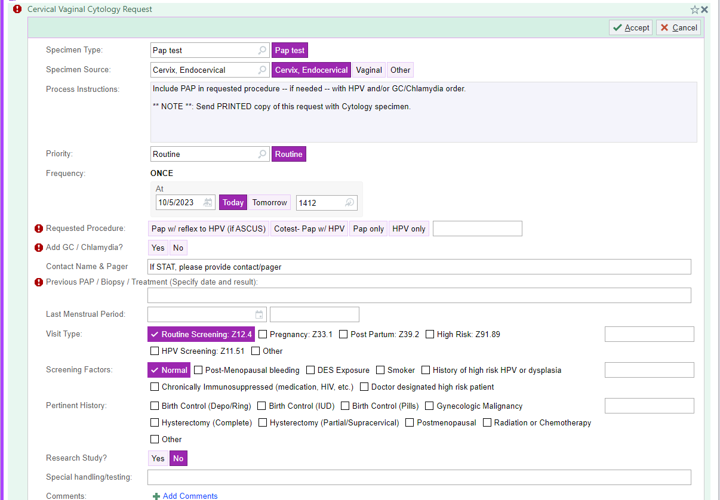
Specimen Submission – Paps
Example: Pap Order

Slide 15
Surgical Specimen for Pathology Submission
Intra-Operative Consultation
Frozen Section
Gross Margins
Breast
Lymphoma
POC
Gout (Tissue)
Routine Pathology
Routine Pathology
No Fix
No Fix
No Fix
No Fix
No Fix
No Fix
No Fix
Formalin
Deliver ASAP
Must deliver
within 30 min
Verbal Notification required at delivery (Face to Face or Vocera)
Deliver to:
Monday – Friday 8am – 4pm: Gross Room
Off Hours and Weekends: Clinical Lab

Slide 16
Specimen Submission – Breast
Breast Specimen
Breast specimens have a fixation time requirement – the specimen must be in formalin within 60 minutes of removal.
Must be delivered to Pathology within 30 minutes to allow for the PA to triage, ink, and open to allow for the formalin to reach the tumor or lesion
Submission
Large tissue specimens must be fresh and placed in an empty container.
Biopsies may be placed directly into formalin.
Breast Protocol Order
Enter as a Surgical Pathology Request
Under “non-frozen attributes” select “Fresh with Special Studies” and select “Breast”
The time of removal and the time in formalin must be accurately recorded to ensure regulatory compliance
Each submission/bucket must be a separate specimen.
For specific collection or ordering questions, call the gross room at 720-516-2096

Slide 17
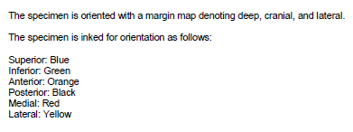
Specimen Submission – Breast
Why the 30 minute requirement
Breast and any tissue with potential or suspected metastatic breast cancer must be fixed in formalin within 60 minutes of time of removal from the body, so why does Pathology need it within 30 minutes?
When breast is delivered to Pathology, the PA must triage the breast BEFORE it is placed in formalin and these items are included in the report.
The breast is evaluated for orientation, follow up may occur if orientation is unclear
Ink is applied in a specific pattern to enable orientation based on color
The breast/lump is then sectioned to open up the tissue to allow for adequate formalin fixation
Example Report Elements:

Slide 18
Pathological Evaluation – Breast
Why the fixation requirement
Estrogen Receptors, Progesterone Receptors, and Her2 Receptors are evaluated if tumor is identified in the breast
The FDA and CAP guidelines require that all specimens stained for these receptors follow strict fixation guidelines.
The specimen must be fixed in formalin within 60 minutes of removal
The specimen must have a minimum fixation time of 6 hours
The specimen must have a minimum fixation time of 72 hours
What do these receptors tell us?
Estrogen Receptor (ER) – if positive, the patient will potentially respond to hormone-targeted therapy
Progesterone Receptor (PR) – if positive, the patient will potentially respond to hormone-targeted therapy.
If positive for both, this indicates that the patient will potentially have a great response to hormone-targeted therapy
Her2 Receptor (Her2) – if positive, the patient will potentially respond to targeted antibody therapy

