Slide 1
THE POWER OF
ADVANCED MEDICINE
Coagulation Collection, Processing, Batching & Receipt of Outreach Specimens

Slide 2
Instructions for Coagulation Testing – Outreach Locations
Collection
Processing & Checking for Clot
Batching & Transport
Integrity Check upon Receipt at Performing Location
2

Slide 3
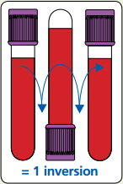
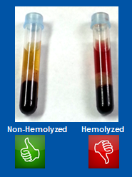
Off-Site Collections – Outreach Locations
One of the most important components of performing any laboratory test is the collection process. The collection process utilized, directly impacts the quality of the specimen that is being collected. If specimens are not collected appropriately, inaccurate results could be used to determine treatment or care of the patient. Specimen collection best practices should always be utilized to prevent a recollection due to poor quality. The most common recollection reasons for coagulation testing are described below.
Insufficient Volume
Clotting
Hemolysis
Failed Integrity Check
Always make sure to pay close attention to the fill-line on each container. This is the intended volume of blood that needs to be added to the anticoagulant additive within the container to produce the best result.
Best practice is to utilize a vacutainer collection system, allowing the container to fill to the fill-line.
If using a butterfly needle, make sure to, “Take the Time to Clear the Line,” utilizing a waste tube to ensure that the air is removed from the line. This is the biggest contributor to rejected samples needed for coagulation testing. If you do not “clear the line,” your specimen container will fill half with air and testing will not be performed.
Many orders are built to print a label based on the volume required for testing. The number of containers requested for testing is based on each container being filled to the fill-line. If two labels print, two containers adequately filled to the fill-line should be sent to ensure there is enough volume to perform all testing requested.
A specimen must be gently inverted 8-10 times to ensure the blood has thoroughly mixed with the anticoagulant additive in the tube, which helps to prevent clotting.
Specimen should be immediately inverted upon collection or the clotting process may begin prior to inversion.
Use 21 gauge needle or larger
Allow alcohol to dry thoroughly
Gently invert 8-10 times; forcefully shaking will cause hemolysis.
Needle placement; bevel up.
Angling the collection container so the blood hits the wall of the container rather than the bottom will minimize the risk of hemolysis.
Leaving a tourniquet on for more than 1 minute can cause hemolysis.
Putting too much pressure on the vein from the vacutainer container or syringe, or too much pressure when transferring blood from a syringe to container increases the risk of hemolysis.
Specimen arrives at the testing site not on dry ice: Reject
Specimens must be transported on dry ice to the testing site.
Appropriate number of aliquots sent based on tests ordered.
Only certain tests can share an aliquot due to Special Coagulation Testing Schedule.
Holding tube upright, gently invert 180° and back
3

Slide 4
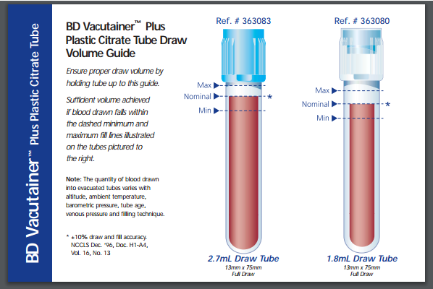
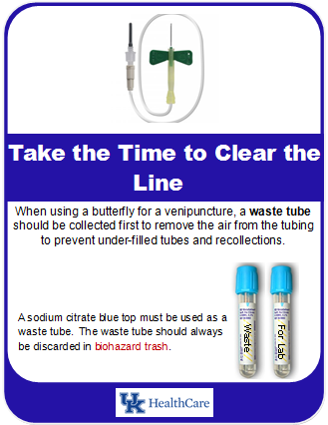
Collection - Providing Adequate Volume
It is extremely important to ensure the proper blood to anticoagulant ratio. This can be achieved by paying close attention to the fill-line and by utilizing a waste tube if collecting via a butterfly needle.
4

Slide 5
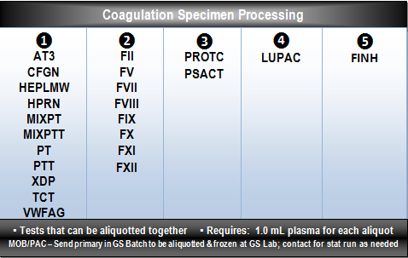
Processing & Checking for Clots for Coagulation Specimens
Only certain coagulation testing is performed on demand ① at Chandler. The remaining tests are batch tested on specific days of the week on various shifts ②-⑤. Therefore, only certain tests can be aliquotted and frozen together.
Verify volume of blood to anticoagulant is acceptable.
Visually check for a clot.
Centrifuge to remove cells from the plasma.
Aliquot appropriately as shown on the Coagulation Specimen Processing card, grouping appropriate testing together.
Each aliquot requires 1.0mL of plasma.
After aliquotting, physically check for clot using applicator sticks (see slide 6).
Place aliquot(s) in freezer or directly in sealed bag inside shipper cooler covering with dry ice.
Specimens collected within the last hour of the day must be centrifuged and aliquotted appropriately.
MOB & PAC locations will send all blue tops stat to Good Sam for processing, testing & transport to Chandler when appropriate.
KY Clinic Lab & Pediatric Lab will send blue tops to Lab Central via Tug robot for processing & testing.
5

Slide 6
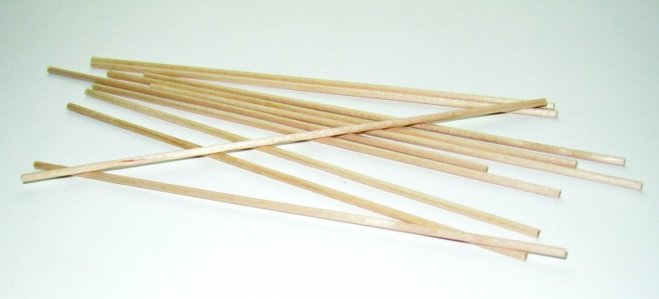
Physically Checking for Clots
After all the plasma necessary for testing has been removed from the primary sodium citrate blue top container, it is critical to physically check for a clot in the remaining cells to ensure the quality of the specimen. Clotted specimens can impact coagulation results, therefore, clot checking is a critical component of the pre-analytical process.
After aliquotting the appropriate amount of plasma necessary for testing, a clot check must be performed to ensure a quality specimen is being submitted for patient testing.
Using two aligned applicator sticks, insert sticks into the bottom of the primary container, scooping upwards through the cells multiple times looking for clots and micro-clots.
Remove applicator sticks from the primary container and check to ensure that no clots are attached to the applicator sticks.
Dispose of applicator sticks in biohazard trash.
6

Slide 7
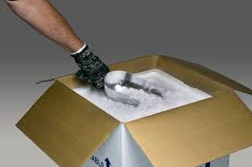
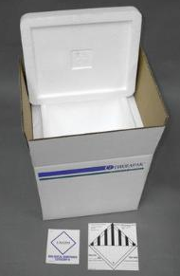
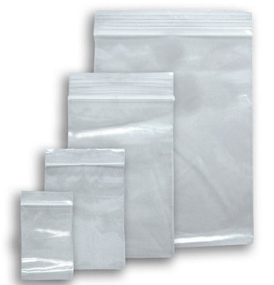
Batching & Transporting Coagulation Specimens
Specimens transported on dry ice must be batched together so that they can be prioritized once arriving at the performing lab. The batch must be prepared accordingly to ensure specimen integrity.
Only specimens transported on dry ice should be batched together to ensure proper prioritization once arriving at the testing location.
Prepare shipper cooler and outer box.
Scan all CID’s requiring dry ice transport onto a single batch and place in a sealed bag.
Place sealed bag in bottom of prepared shipper cooler.
Add dry ice on top of the sealed bag of specimens in the shipper cooler; enough to cover all specimens.
Batch manifest should not be placed in the cooler with the dry ice. Place between the Styrofoam cooler and outer shipper box.
7

Slide 8
Receiving Batch - Coagulation Specimens
Specimens transported on dry ice must be prioritized and the specimen integrity immediately checked and maintained. The following steps should be followed when a dry ice shipper cooler arrives in the performing laboratory for testing.
Immediately accept dry ice shipper cooler directly from courier, verifying specimens are received on dry ice.
Remove the batch manifest and disband the batch in Sunquest, leaving the aliquots on dry ice.
Check each aliquot label to ensure all tests are appropriately grouped as shown on the Coagulation Specimen Processing card.
Do not place aliquots on MPA for receipt! Individually receive each via Sunquest ORM.
Immediately following receipt of each aliquot, walk all aliquots to the Coagulation area.
Any tests in category ① should be placed directly in the water bath, timer set & Coagulation Tech notified. Coagulation Tech will re-centrifuge aliquot after thawing, to ensure platelet-poor plasma prior to testing.
Any tests in categories ②, ③, ④, & ⑤ must be handed directly to the Coagulation Tech to place in the freezer for storage until batch testing occurs. Do NOT place in a rack and walk away.
Good Sam processors will receive the primary blue containers from MOB & PAC to receive, process & test. For testing not performed at GS, processor will refer to slides 5, 6 & 7.
8

Slide 9
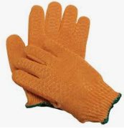
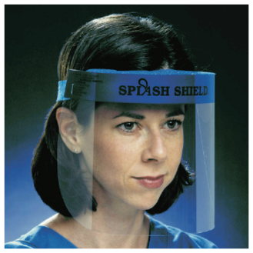
Dry Ice Storage & Personal Protective Equipment
Each employee handling dry ice must review the Cryogenic Materials: Guidelines for Safe Handling Procedure, LAB SAFETY 1011.01
STORAGE of DRY ICE
Dry ice is to be stored in well-ventilated locations and placed in insulated and ventilated storage areas, insulated coolers, or special coolers designed for the storage of dry ice.
Because of the thermal expansion of dry ice, (one pound of dry ice produces about 250 liters of gaseous carbon dioxide), sufficient gaseous carbon dioxide can be released in a sealed container to cause a pressure explosion.
Dry ice is NEVER to be stored in any type of tightly sealed devices such as an ultra-low freezer or plastic/glass container.
Dry ice will sublimate about five to ten pounds every 24 hours (blocks last longer) in a typical storage cooler.
Normal air is composed of 78% nitrogen, 21% oxygen, and only 0.04% carbon dioxide. Concentrations greater than 0.5% (5000 ppm) can become dangerous. Storage and operation locations must be periodically surveyed to ensure carbon dioxide levels remain below 5000 ppm .
Storage areas have alarm sensors to monitor the carbon dioxide level. If the warning light or audible alarm is on, fully open the door until the oxygen level returns to normal.
PERSONAL PROTECTIVE EQUIPMENT
Protective Gloves: Impermeable/loose fitting (leather)
Eye Protection: Safety glasses
9

Slide 10
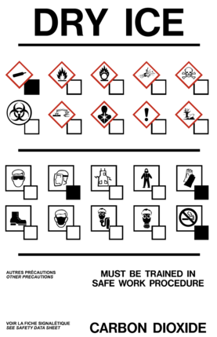
Safety Hazards & Disposal of Dry Ice
Hazards/Precautions
Burns/frostbite: Dry ice can cause burns to the skin in short periods of times. Thermal rated gloves are to be used to handle dry ice.
Suffocation: carbon dioxide is a simple asphyxiant. Always store dry ice in a well-ventilated area to minimize the buildup of carbon dioxide. Personnel must use caution should dry ice be stored in a deep cooler. Personnel must be trained to never stick their head into the chest to obtain dry ice.
Explosions: Placing dry ice into a tightly sealed container can permit sufficient gas build up to cause an explosion. Never place dry ice inside an ultra-low freezer or other enclosed space. Placement of dry ice in rooms with little or no ventilation can result in a build-up of the carbon dioxide in the area. Do not store dry ice in a confined area such as in walk-in coolers, refrigerators, freezers, or closets.
Report injuries from dry ice using the on line Incident Report system (see lab policy LAB 086 Incident Reporting)
When using dry ice to ship materials, the shipper must follow all applicable shipping regulations.
Disposal of unneeded dry ice is accomplished by:
Letting the unused portion sublimate (recommended for well-ventilated locations because it will occur over a period of several days and the ventilation will take care of the gas liberated);
To dispose of the dry ice received in shipment of reagents/supplies leave the dry ice in the shipping container, do not tightly seal the container, and place the container in a well-ventilated area until the ice sublimates.
Never dispose of dry ice in a sink, toilet or other drain (such action can destroy the structure because of the temperature difference);
Never dispose of dry ice in the trash or garbage or place unneeded dry ice in corridors (some corridors may not be well ventilated and the oxygen level can be reduced to low levels).
10

Slide 11
Miscellaneous
Out of dry ice?
Leave aliquot in the freezer
Request dry ice from Client Services.
Contact Information
Email Labclientservices@uky.edu
Call Client Services at 323-3623
If unable to reach Client Services, contact Lab Central at 323-5431 or 323-5432
11

Slide 12
Employee Sign-Off
Employee Statement:
I have received information and instructions regarding coagulation specimen collection, processing, batching & receipt, as outlined in this PowerPoint. I have had the opportunity to ask questions, and those questions have been answered to my satisfaction. As a result of this training, I understand the measures I must take to effectively perform my job.
I have reviewed Cryogenic Materials: Guidelines for Safe Handling Procedure, LAB SAFETY 1011.01.
Together, WE ARE POWERFUL.
Employee Signature: ________________________ Date: _____________
12
Notes:
For your presentation summary slide be sure to end on a powerful note. Not necessarily what is listed above, verbatim, but a strong message of encouragement. The background image here is not editable.

