Slide 1
THFW Laboratory
Specimen Collection and Labeling
Notes:
Lab’s accrediting agencies require a physician order for all lab tests performed.

Slide 2
Patient Identification
Joint Commission 2025 Hospital and Laboratory National Patient Safety Goal (NPSG 01.01.01)
Use at least two ways to identify patients. For example, use the patient’s name and date of birth. This is done to make sure that each patient gets the correct medicine and treatment.

Slide 3
Misidentification/Mislabeling
Technology alone cannot ensure accurate patient identification. The approach to this issue must be patient-centric, comprehensive, and systematic considering not only the technology but also the people.
Accurate patient identification requires shared responsibility and their processes. Involvement of organization leadership, providers, and frontline staff is ESSENTIAL.

Slide 4
ORDERS
All lab specimens must have an appropriate provider order.
Notes:
Lab’s accrediting agencies require a physician order for all lab tests performed.

Slide 5
Blood Bank Specimen and Product Pick-up: 3rd Patient Identification Verification
Patient name and DOB
AND
The BBID Band
  Has a number that is unique to that specific collection and blood products.
OR
Lattice

Slide 6
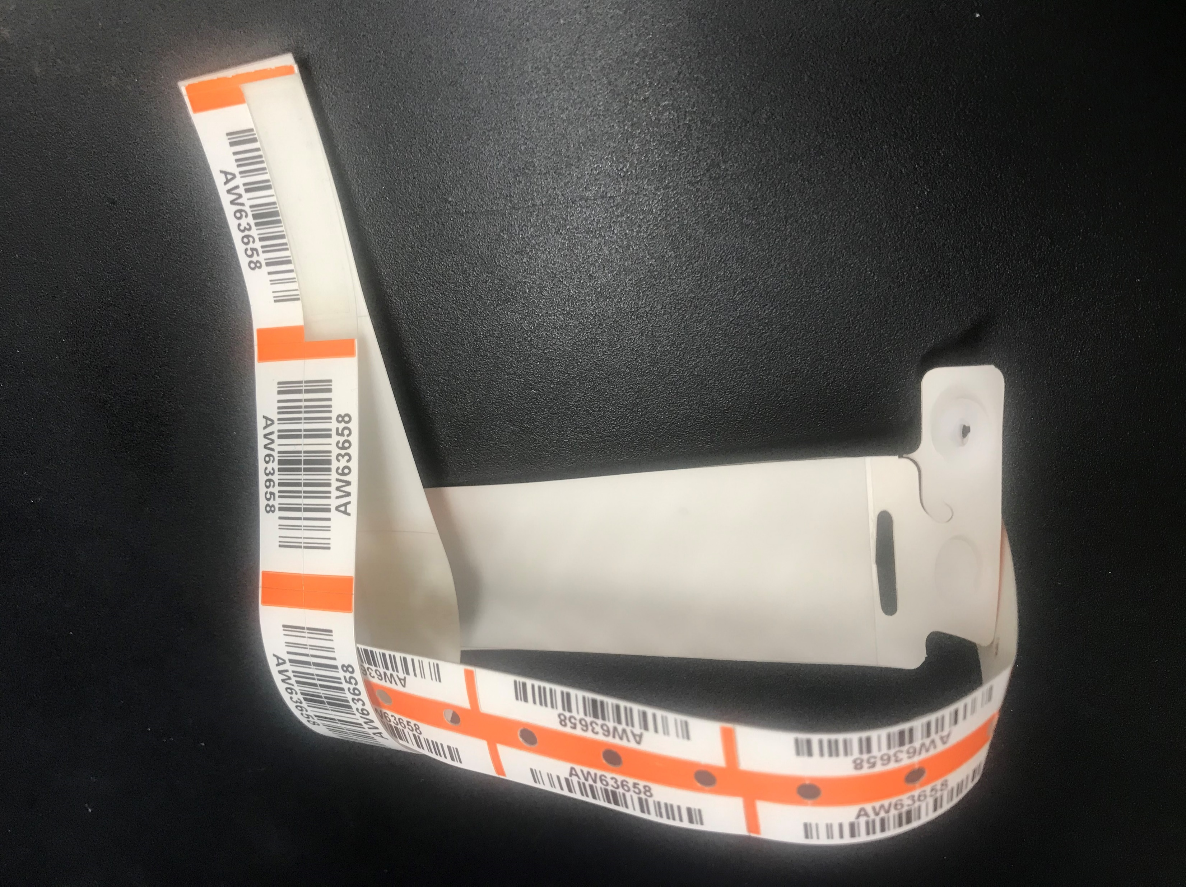
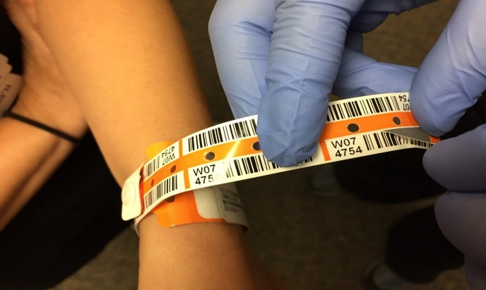
Blood Bank Specimen and Product Pick-up: BBID
Only Doe patients and NICU will use BBID for T/S and T/C collections.

Slide 7
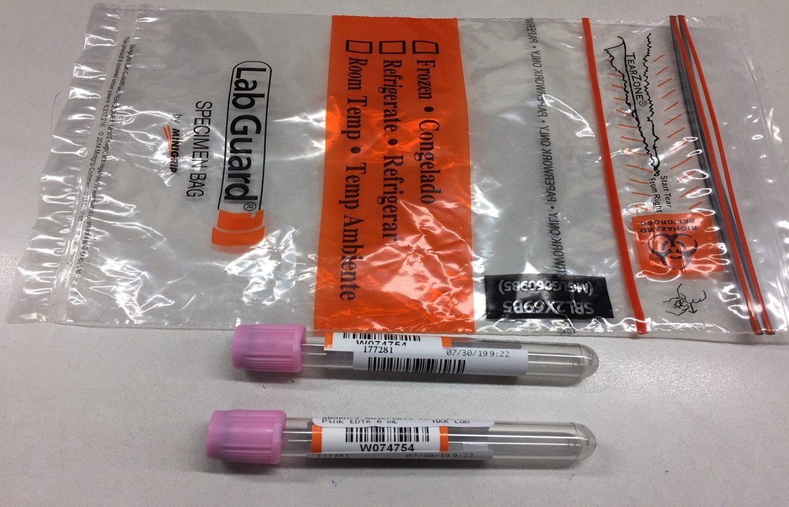
Blood Bank Specimen and Product Pick-up: BBID
Collect and label Patient Doe’s Blood Bank samples.
Peel off the bar code label from the tail. Apply it to the collected tubes.
Tear the tail off at perforation.
Make a loop with the tail around the BBID armband.
Send labeled samples to Blood Bank.

Slide 8
Blood Bank Specimen and Product Pick-up: BBID Doe Patients
Once a BBID is placed on your Doe patient, it MUST be used until the T/S expires, even if:
  Transferred from ED to Unit.
  Patients legal name is verified and updated in CC1.
IF the BBID is removed or lost from your Doe patient during the initial T/S period, a new BBID will need to be placed.
Before picking up blood product apply one label from the patient’s wristband and put it on requisition form.

Slide 9
Blood Bank Specimen and Product Pick-up: Lattice
For all other patients lattice MUST be used for T/S or T/C specimen collections.
  Except during downtime.
The lattice label used MUST be the one associated with the order.
  “EXTRA” labels will NOT be accepted.
Use patient chart label on blood form for product pick-up.
When administering blood
  Documentation field for BBID-> put N/A if patient does not have a BBID.

Slide 10
Blood Bank Specimen and Product Pick-up: Downtime
If Lattice is not available, e.g. downtime, BBID bands are to be used for all patients regardless if a Doe or from NICU.
  Once placed BBID band is NOT to be removed until T/S or T/C expires.
  When T/S or T/C has expired and lattice is back up then the expired BBID can be removed and lattice system can be used.

Slide 11
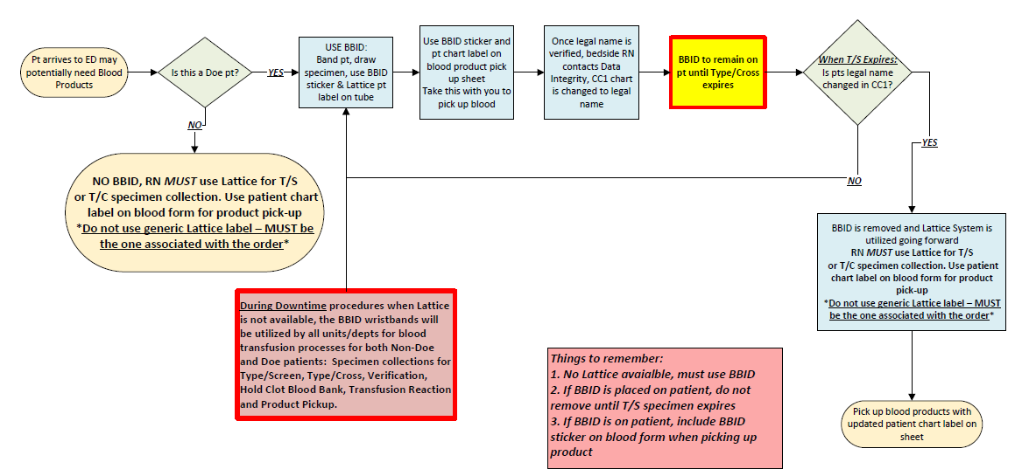

Slide 12
Questions?
Bring them to your unit leaders
OR
Call Blood Bank
Blood Bank Info
Ext. 5651
Tube Station 40

