Slide 1
THFW Laboratory
Specimen Collection and Labeling
Notes:
Lab’s accrediting agencies require a physician order for all lab tests performed.

Slide 2
Patient Identification
Joint Commission 2026 Hospital and Laboratory National Performance Goal (NPG 01.01.01)
Use at least two ways to identify patients. For example, use the patient’s name and date of birth. This is done to make sure that each patient gets the correct medicine and treatment.

Slide 3
Misidentification/Mislabeling
Technology alone cannot ensure accurate patient identification. The approach to this issue must be patient-centric, comprehensive, and systematic considering not only the technology but also the people.
Accurate patient identification requires shared responsibility and their processes. Involvement of organization leadership, providers, and frontline staff is ESSENTIAL.

Slide 4
ORDERS
All lab specimens must have an appropriate provider order.
Notes:
Lab’s accrediting agencies require a physician order for all lab tests performed.

Slide 5
Blood Bank Specimen and Product Pick-up: 3rd Patient Identification Verification
Patient name and DOB
AND
The BBID Band
  Has a number that is unique to that specific collection and blood products.
OR
Rover/Beaker/CC1

Slide 6
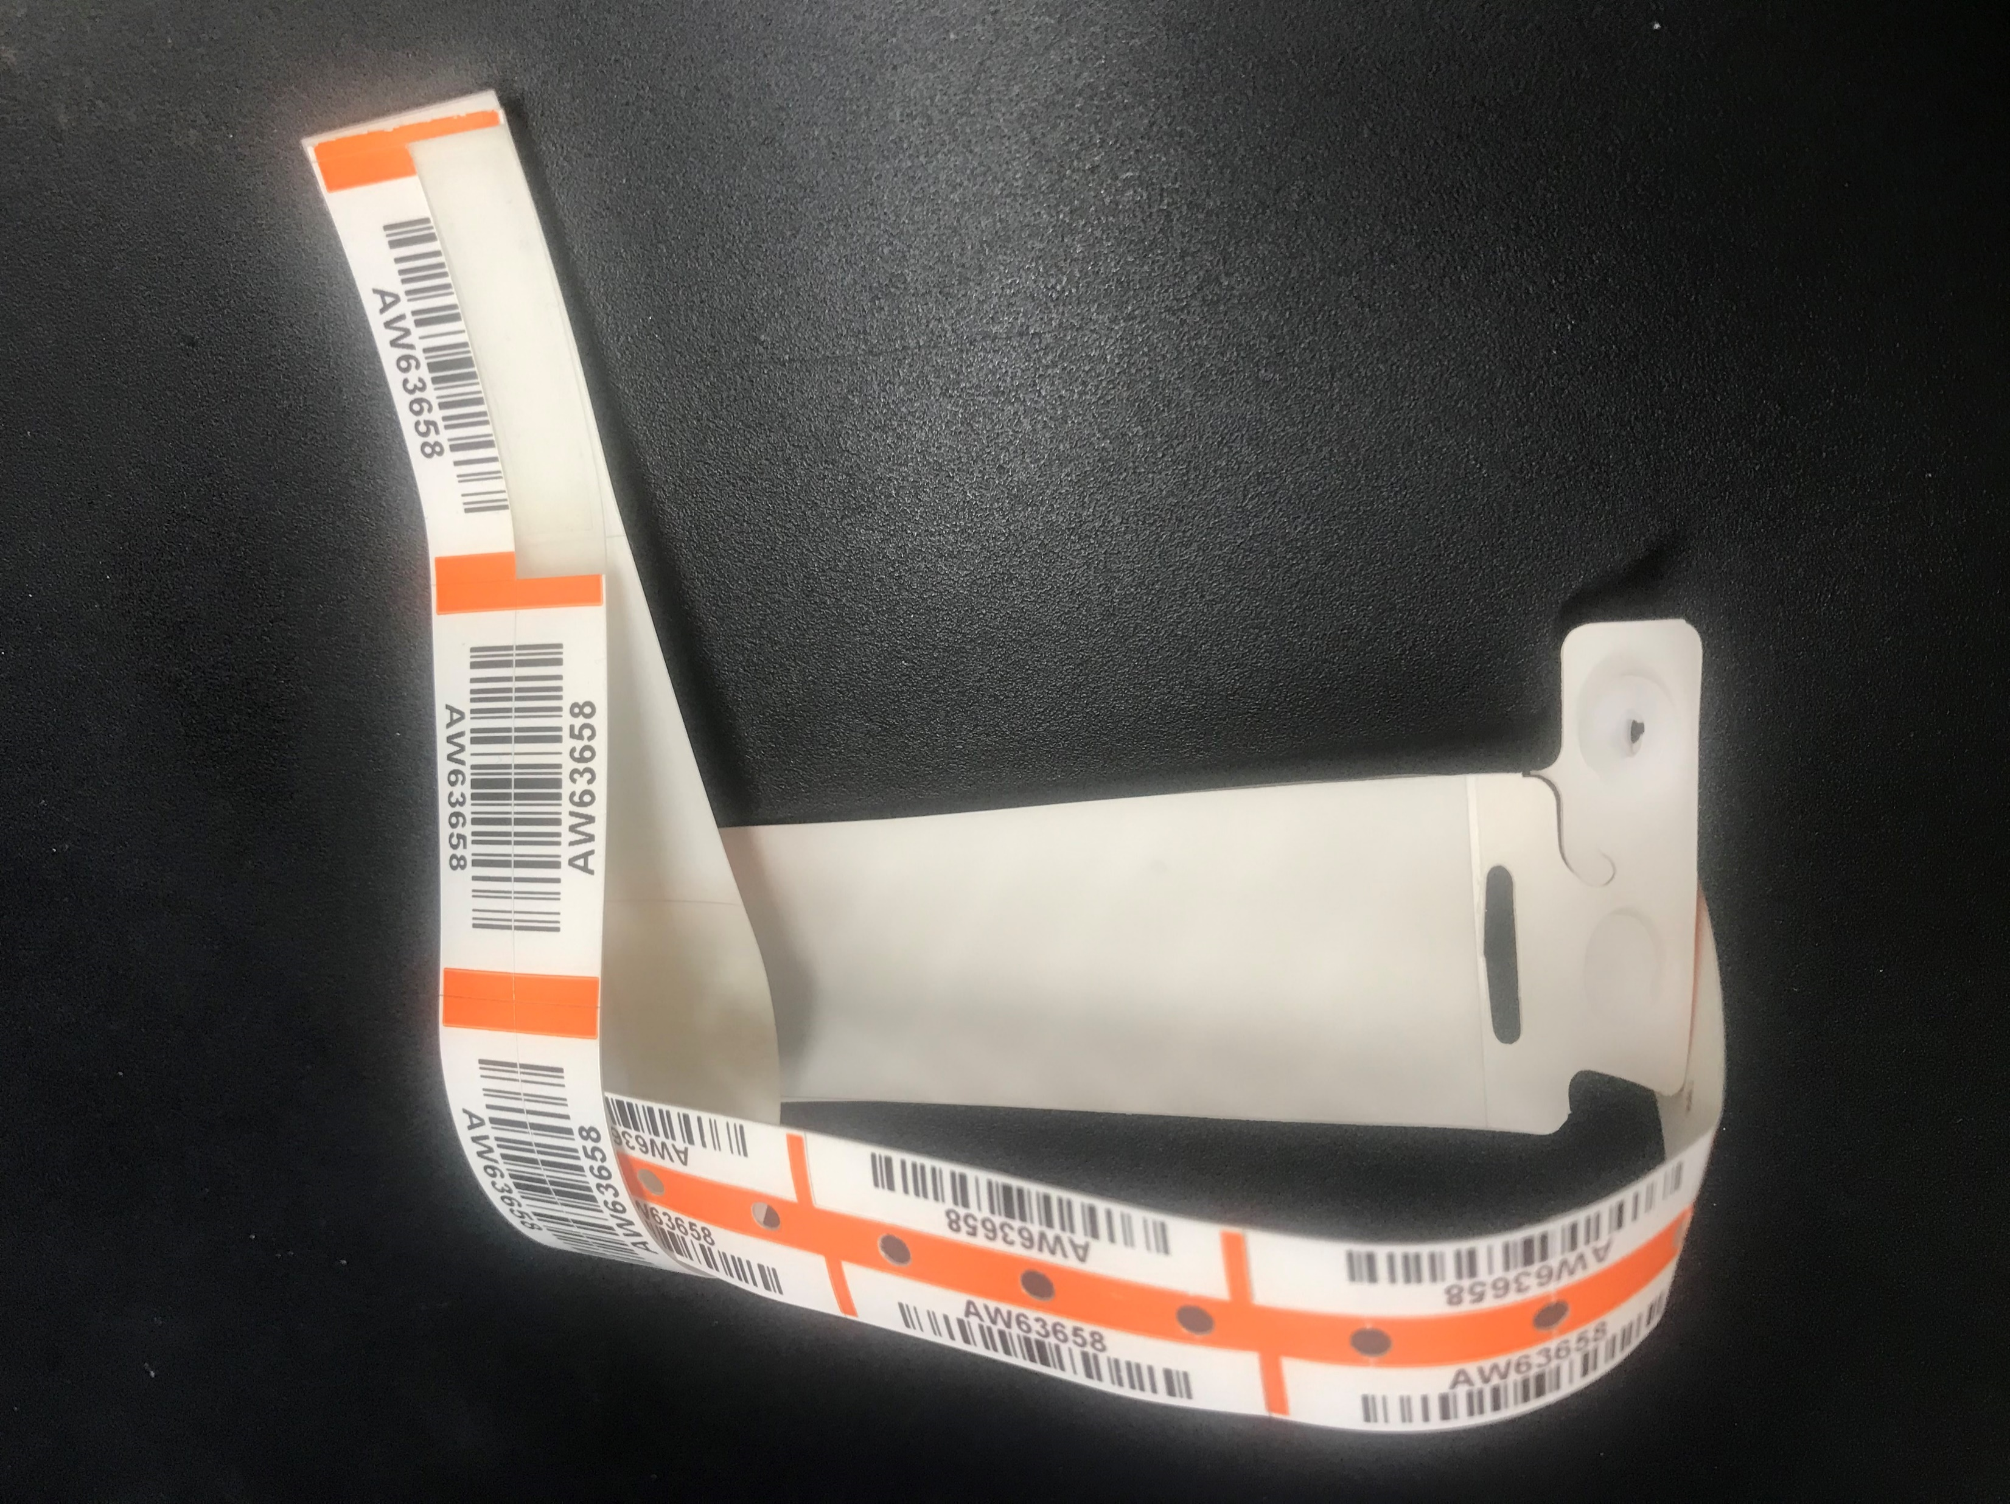
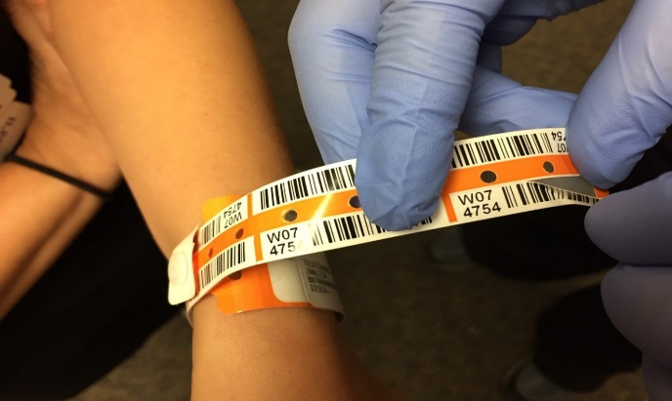
Blood Bank Specimen and Product Pick-up: BBID
Only Doe patients and NICU will use BBID for T/S and T/C collections.

Slide 7
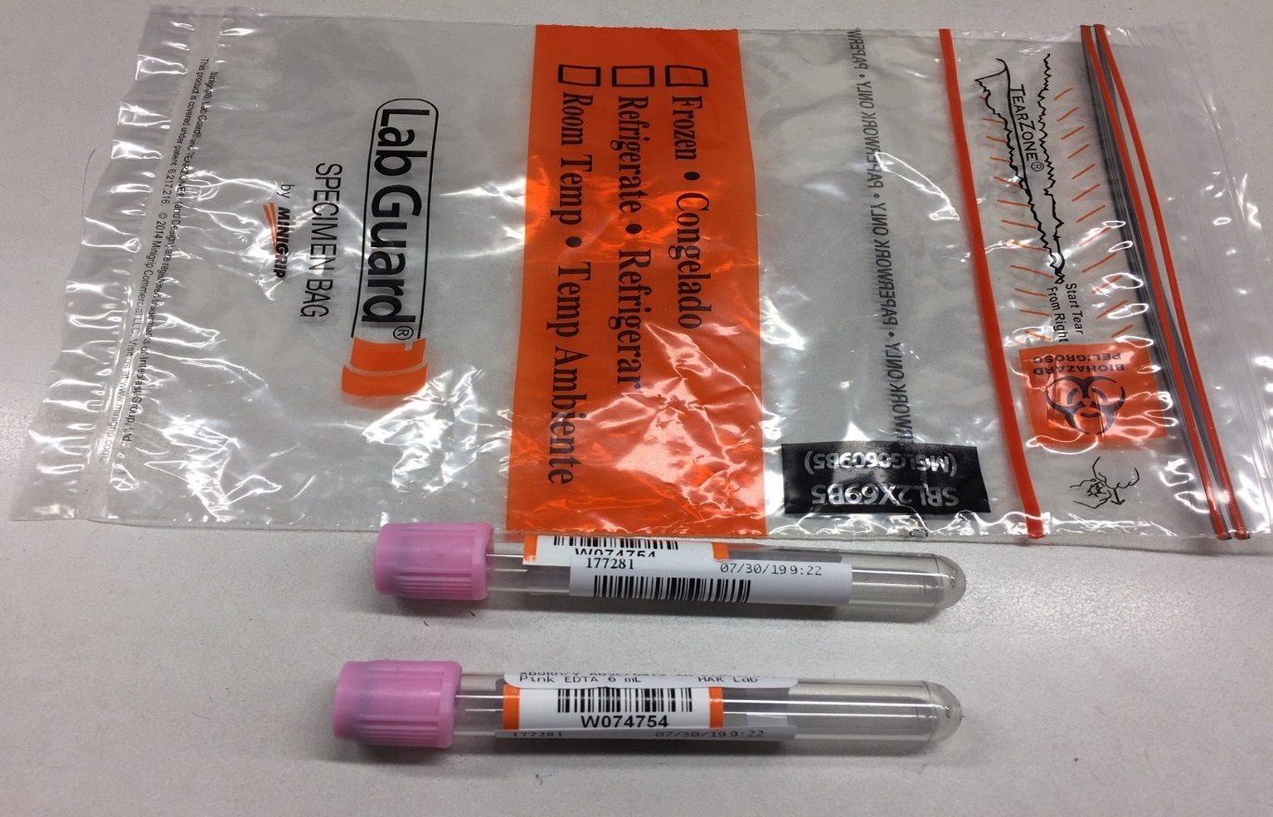
Blood Bank Specimen and Product Pick-up: BBID
Collect and label Patient Doe’s Blood Bank samples.
Peel off the bar code label from the tail. Apply it to the collected tubes.
Tear the tail off at perforation.
Make a loop with the tail around the BBID armband.
Send labeled samples to Blood Bank.

Slide 8
Blood Bank Specimen and Product Pick-up: BBID Doe Patients
Once a BBID is placed on your Doe patient, it MUST be used until the T/S expires, even if:
  Transferred from ED to Unit.
  Patients legal name is verified and updated in CC1.
IF the BBID is removed or lost from your Doe patient during the initial T/S period, a new BBID will need to be placed.
Before picking up blood product apply one label from the patient’s wristband and put it on requisition form.

Slide 9
Blood Bank Specimen and Product Pick-up: Rover/Beaker/CC1
For all other patients Rover/Beaker/CC1 MUST be used for T/S or T/C specimen collections.
  Except during downtime.
The Rover/Beaker/CC1 label used MUST be the one associated with the order.
  “EXTRA” labels will NOT be accepted.
Use patient chart label on blood form for product pick-up.
When administering blood
  Documentation field for BBID-> put N/A if patient does not have a BBID.

Slide 10
Blood Bank Specimen and Product Pick-up: Downtime
If Rover/Beaker/CC1 is not available, e.g. downtime, BBID bands are to be used for all patients regardless if a Doe or from NICU.
  Once placed BBID band is NOT to be removed until T/S or T/C expires.
  When T/S or T/C has expired and Rover/Beaker/CC1 is back up then the expired BBID can be removed, and Rover/Beaker/CC1 system can be used.

Slide 11
USE BBID: Band Pt, draw specimen, use BBID sticker & Rover/Beaker/CC1 label on tube
Use BBID sticker and pt chart label on blood product pick up sheet Take this with you to pick up blood
Once legal name is verified, bedside RN contacts Data Integrity, CC1 chart is changed to legal name
BBID to remain on pt until Type/Cross expires
When T/S Expires:
Is pts legal name changed in CC1?
Pt arrives to ED may potentially need Blood Products
Is this a Doe pt?
YES
NO
NO
NO BBID, RN MUST use Rover/Beaker/CC1 for T/S pr T/C specimen collection. Use patient chart label on blood form for product pick-up *Do not use generic labels – MUST be the one associated with the order*
YES
BBID is removed and Rover/Beaker/CC1 is utilized going forward
RN MUST use Rover/Beaker/CC1 for T/S or T/C specimen collection. Use patient chart label on blood form for product pick-up
*Do not use generic labels – MUST be the one associated with the order*
During Downtime procedures when Rover/Beaker/CC1 is not available, the BBID wristbands will be utilized by all units/depts for blood transfusion processes for both Non-Doe and Doe patients: Specimen collections for Type/Screen, Type/Cross, Verification, Hold Clot Blood Bank, Transfusion Reaction and Product Pickup.
Things to remember:
No Rover/Beaker/CC1 available, must use BBID
If BBID is placed on patient, do not remove until T/S specimen expires
If BBID is on patient, include BBID sticker on blood form when picking up product
Pick up blood products with updated chart label on sheet

Slide 12
Questions?
Bring them to your unit leaders
OR
Call Blood Bank
Blood Bank Info
Ext. 5651
Tube Station 40

