Slide 1
UNIVERSITY of ILLINOIS
HOSPITAL & CLINICS
Blood Specimen Collection
Educational Overview

Slide 2
Course Outline
Laboratory Test Information
Proper Patient Identification
Specimen Collection:
  Venipuncture
  Fingerstick
  Heelstick
  Arterial Blood Gas
  Blood Cultures

Slide 3


Slide 4


Slide 5
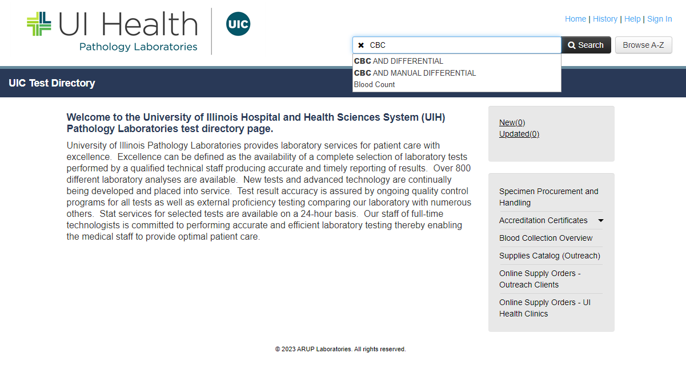

Slide 6
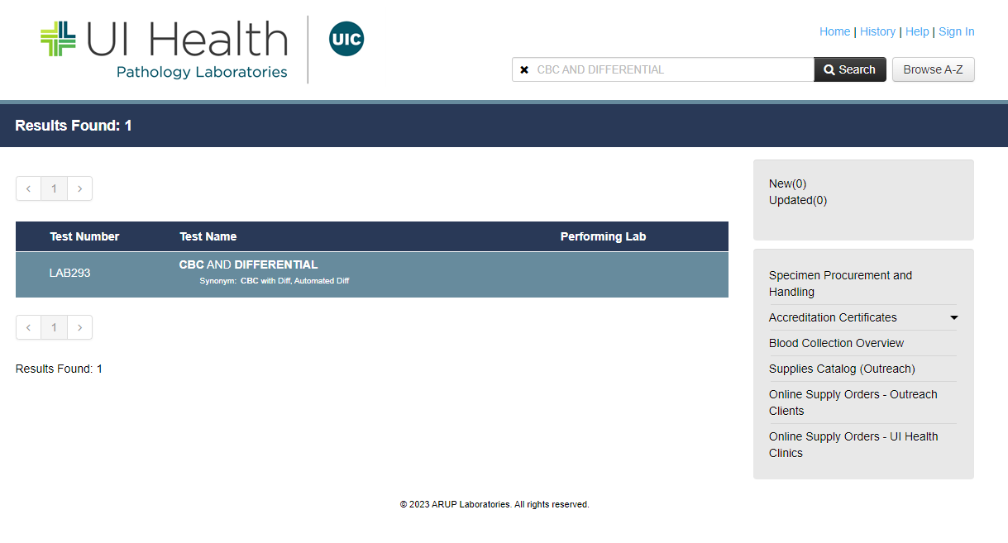

Slide 7
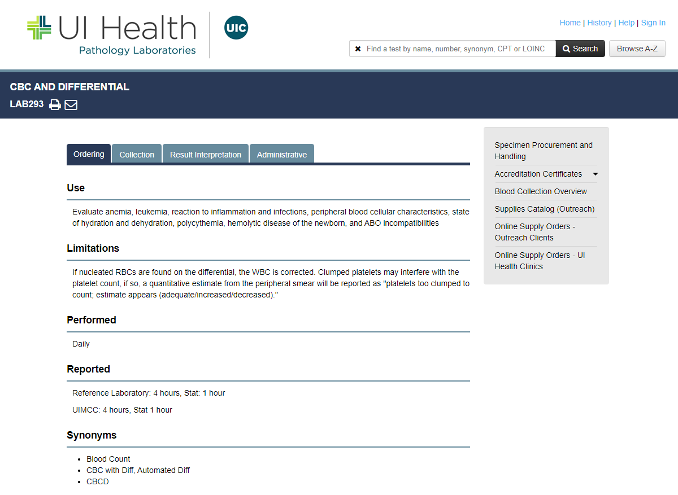

Slide 8
Lab test information provided:
Lab where test is performed
Availability
Turn around Time (TAT)
Special Instructions
Specimen type
Volume of sample
Minimum volume needed
Collection container
Collection type
Transport instructions
Storage Instructions
Causes for Rejection
Normal Values–Reference Ranges
Critical Values
Test Limitations

Slide 9
Lab Specimen Collection
Over 80% of the objective information used in diagnosis and treatment decisions for patients comes from laboratory testing!
We play an important role in this process
Accurate Patient Identification = Timely Results
Quality Lab Sample = Quality Test Result

Slide 10
Impact of rejected blood samples
Patient Safety & Experience:
Delay in results
Delay in treatment
Delay in Discharge
Dissatisfaction: additional needle stick and blood loss
Lab and Clinical Staff:
Additional work
Additional cost (time, supplies)
Delay in processing other tests, increased STATS

Slide 11
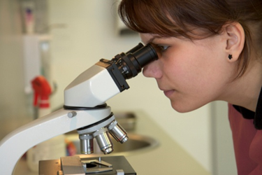
Causes for Rejected Blood Specimens
Hemolyzed sample
  (Note: Hemolysis is largely associated with sample collection process. Ensure proper drawing techniques are exercised during collection of sample to avoid hemolysis.)
2. QNS (quantity of sample not sufficient)
3. Wrong collection tube
4. Inaccurate paperwork

Slide 12
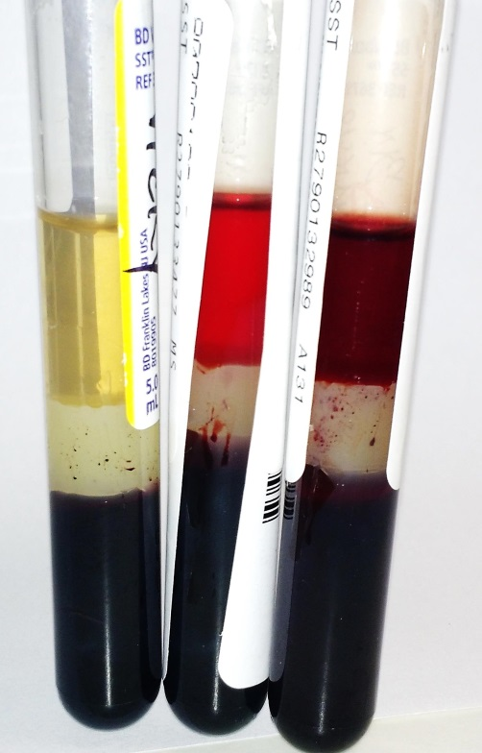
1. Hemolysis
What is hemolysis? The breaking open of red blood cells.
The red cell membrane is fragile and easily damaged if blood specimens are mishandled.
When the red cell membrane breaks other cellular contents, e.g., enzymes, electrolytes are released.
The presence of hemolysis invalidates
many test results
Example: Hemolyzed specimens can interfere with liver function tests and potassium levels.
Left sample has no hemolysis. The middle sample has hemolysis and right is grossly hemolyzed.

Slide 13
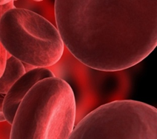
What Causes Hemolysis?
Transferring blood through the needle in a syringe with force into tubes
Mixing the tube too vigorously after collecting the sample,
Puncturing the vein before alcohol dries allows alcohol to mix with the sample
Frothing of the blood when the needle bore is partially inserted in the lumen of the vein
Old sample: collecting the sample “just in case” and not sending it to lab immediately . Blood specimen will break down resulting in inaccurate levels.

Slide 14
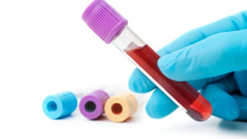
2. Quantity Not Sufficient (QNS)
Sample rejection due to QNS means there was not enough blood in the tube required for testing
Each lab test requires a certain amount of blood in order to be analyzed
You should not “under-fill” or “over-fill” a collection tube
Many collection tubes contain additives
Under-filled tubes will have higher concentrations of additives which can cause erroneous results

Slide 15
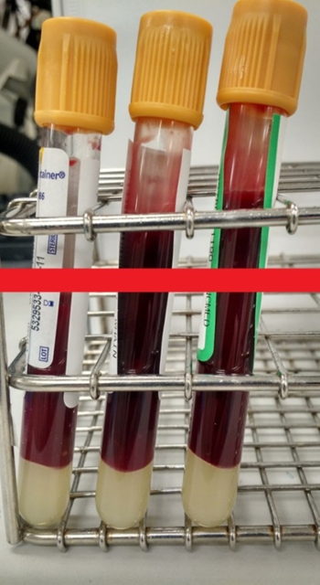
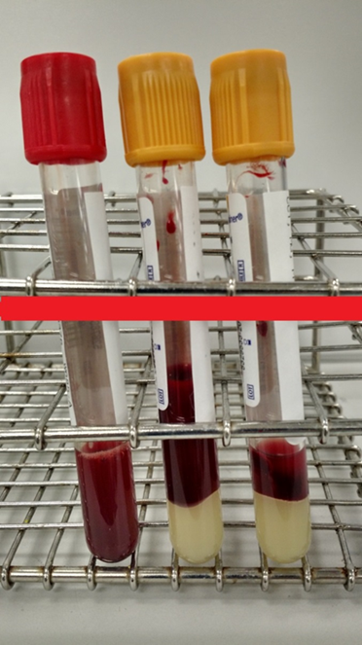

PLEASE ENSURE ADEQUATE BLOOD VOLUME.
FILL LINE
CORRECT
INCORRECT

Slide 16
3. Wrong Collection Tube
There are over 9 types of blood collection tubes
Each lab test requires a specific tube for blood collection
Each tube contains different additives to prepare the blood sample for testing
Each tube should be collected in a specific “Order of Draw” to support quality results
For example: if the additive in the purple stopper tube contaminates the green stopper tube this would cause a falsely decreased calcium and increased potassium.

Slide 17
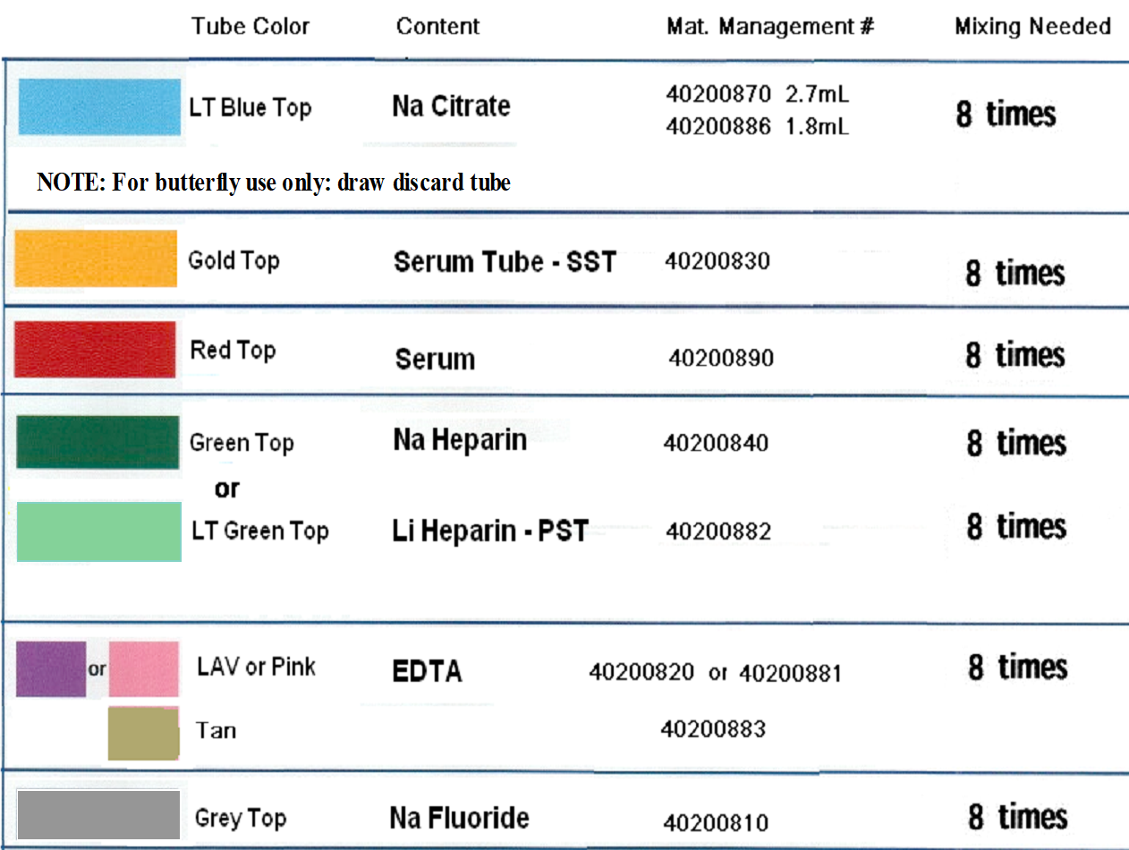
Order of Draw

Slide 18

To help you remember…
Before the
Gold
Rush
Green
Little
Parrots
Turned
Grey

Slide 19
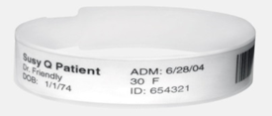
4. Inaccurate paperwork
The most important step in the Specimen Collection process:
PATIENT IDENTIFICATION
Accurately identify the patient using TWO unique identifiers:
Patient’s Full Name and Date of Birth (DOB)
** Never use a room number as an identifier **
Confirm the information on the Patient ID band matches the information on the Lab Order/Requisition.
Always label the specimen in the presence of the patient AFTER the specimen is collected
Rationale: Using two unique identifiers will not assure accuracy if the specimen is removed from the patient’s room without being labeled

Slide 20
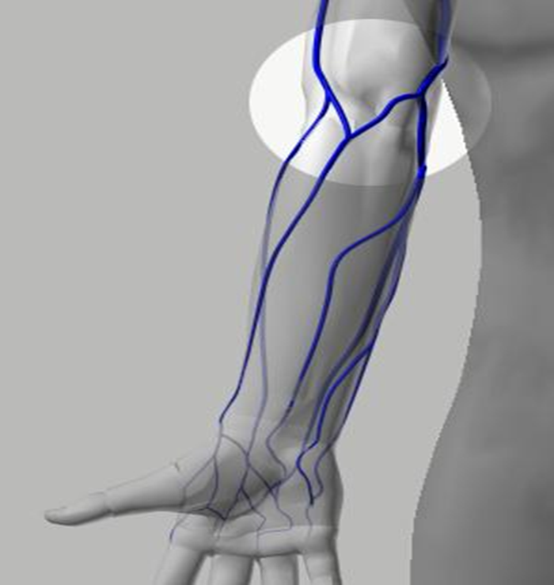
Specimen Collection
Venipuncture Site Selection
The Median Cubital vein is the 1st choice because it is
large,
well-anchored
least painful
least likely to bruise
The Cephalic Vein is the 2nd choice because:
It is not as well anchored
is more painful when punctured than the Median Cubital.
Median Cubital Vein
Cephalic Vein

Slide 21
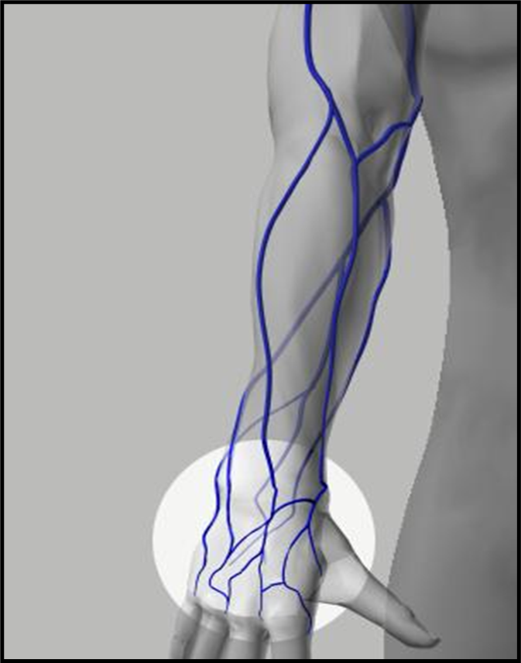
Specimen Collection
Venipuncture Site Selection
Hand or wrist veins:
May be used when Median Cubital or Cephalic veins are unsuitable or unavailable
The clinician must use extra care to anchor them
Have a narrow diameter therefore it may be necessary to use a small gauge needle and small volume evacuation tubes
NOTE:
When drawing tubes from the hand, the use of a butterfly apparatus can be more effective and less painful.
Basilic Vein
Cephalic Vein
Dorsal Metacarpal
Veins

Slide 22
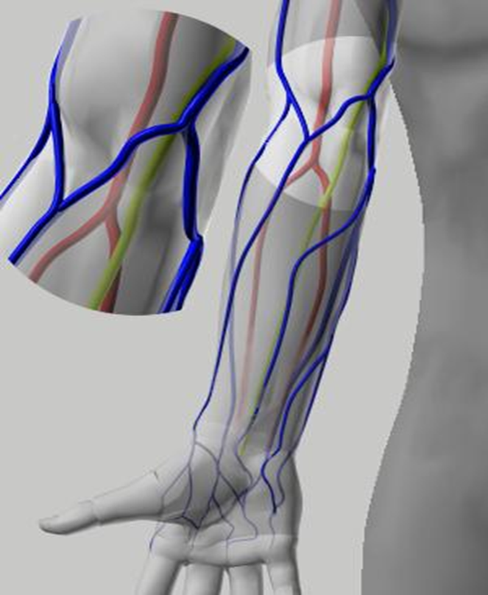
Specimen Collection
Safe Puncture
Brachial Artery
Avoid:
Hitting a nerve
Puncturing arteries
Excessive or blind probing with a needle.
Be aware of site selection when collecting blood samples
Median Nerve

Slide 23

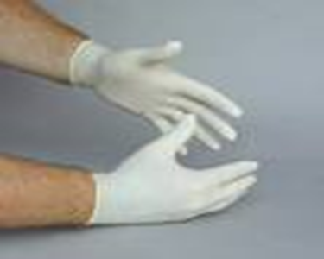
Specimen Collection
Infection Control
Before collecting any blood sample ALWAYS:
Wash your hands! Use soap and water OR waterless hand sanitizer
Put gloves on BOTH hands

Slide 24
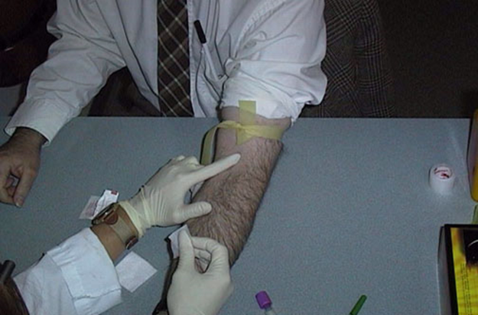
Specimen Collection
Proper Tourniquet Technique
Tourniquet Application:
Should be tight enough to slow venous flow without affecting arterial flow.
Should allow more blood to flow into than out of the area.
Should never be left on a patient longer than one minute.
Should not be applied on the arm of a recent site of a mastectomy

Slide 25
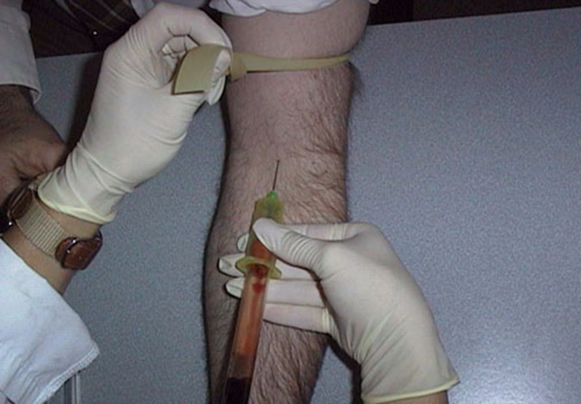
Specimen Collection
Proper Tourniquet Technique
Tourniquet Removal:
Always remove the tourniquet prior to the removal of the needle.
NOTE: Failure to remove the tourniquet before withdrawing the needle maintains pressure on the vein and causes blood to flow out of the vessel.

Slide 26
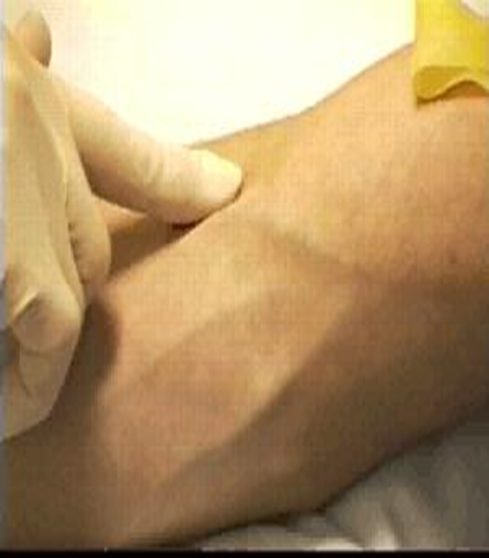
Specimen Collection
Venipuncture
Always use appropriate PPE!
Process:
Use the tip of the index finger to palpate the vein.
  Helps to determine the size, depth, and direction of the vein.
Select a vein which is:
  easily palpated
  large enough to support good blood flow
  well-anchored

Slide 27
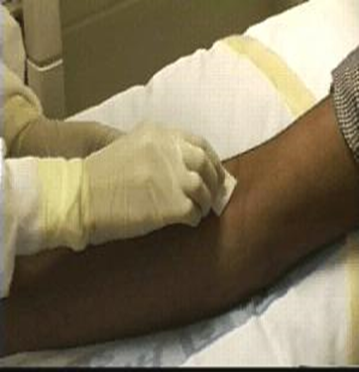
Specimen Collection
Cleansing the site
Thoroughly clean the venipuncture site with an antiseptic. Isopropyl alcohol (70%) is commonly used. Note: The process for cleansing the puncture site when collecting Blood Cultures will be outlined later in the module
Start at the center of the site and move outward in ever widening, concentric circles. Failure to follow this procedure correctly may re-introduce dirt and bacteria to the venipuncture site.
Use sufficient pressure to remove surface dirt.
Let the site air dry prior to beginning the venipuncture. Do not wipe or fan the site, as this may re-introduce contaminants.

Slide 28
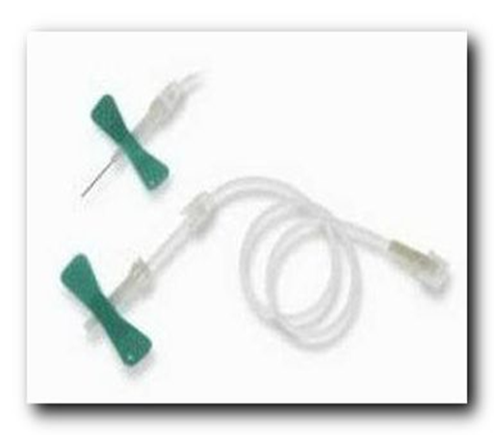
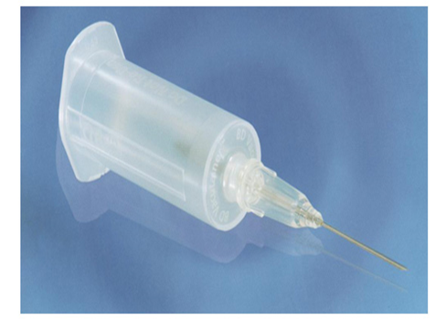
Specimen Collection
Correct Needle Gauge for blood collection
IMPORTANT:
Using the correct needle gauge will result in decreased hemolysis (red cell damage)
The larger the bore of the needle the less chance of hemolysis
Note: needle gauge will vary based on patient size

Slide 29
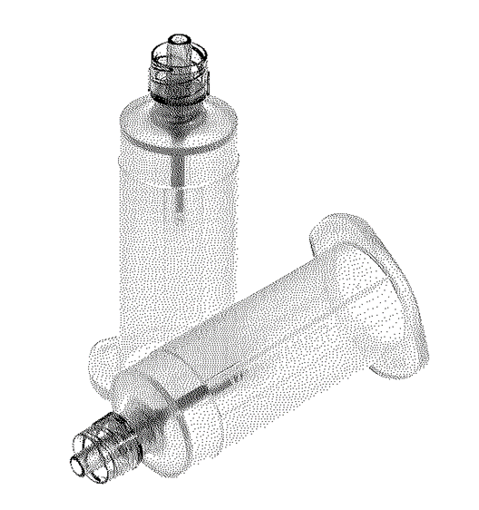
Blood Collection Device
Safety Products
For use during blood sample collection when:
Transferring blood collected into a syringe
Drawing a blood specimen from a line to a collection tube

Slide 30
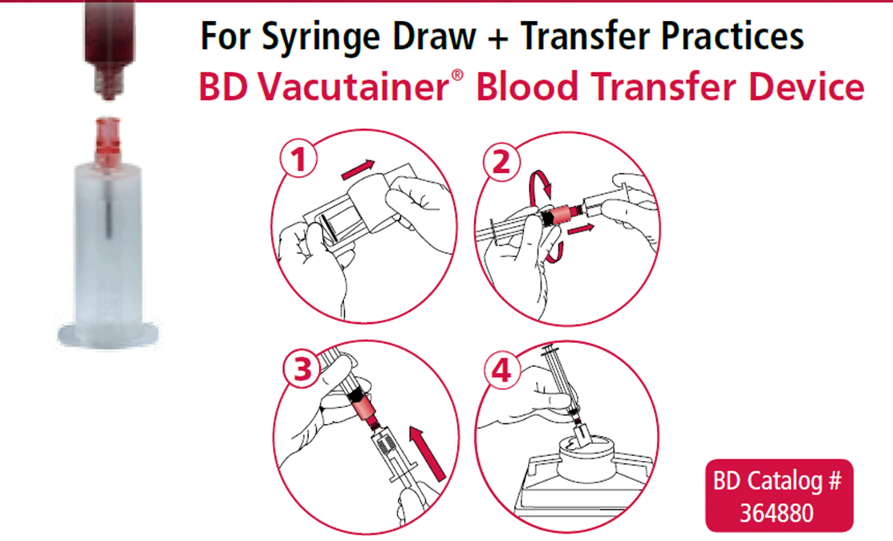
Red tipped transfer device for syringe draws

Slide 31
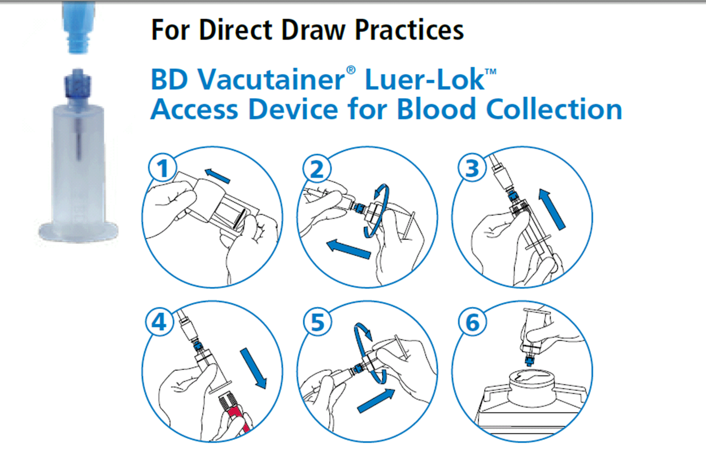
Blue Tipped transfer device for direct line draws

Slide 32
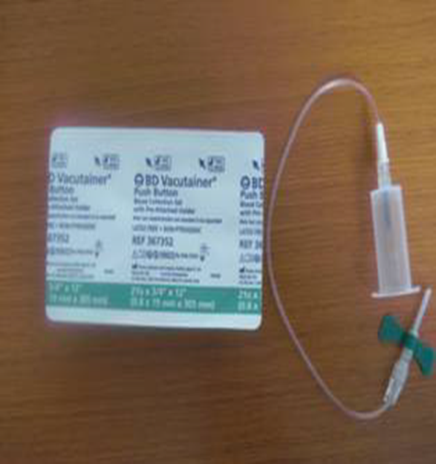
Push Button Butterfly with pre-attached Vacutainer
No assembly required
Comes in 21g, 23g or 25g
Tubing can be detached from vacutainer and connected to a syringe

Slide 33
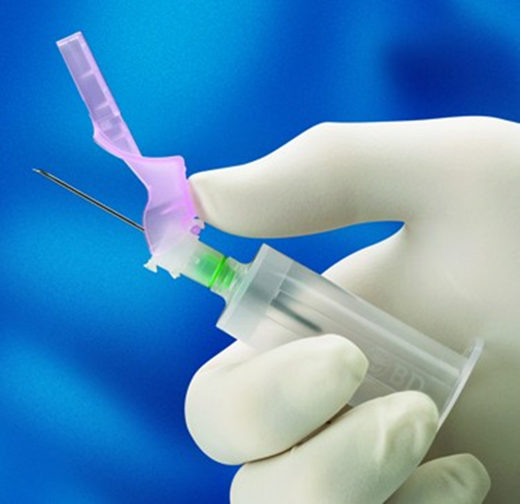

BD Eclipse Needle with pre-attached transfer device

Slide 34
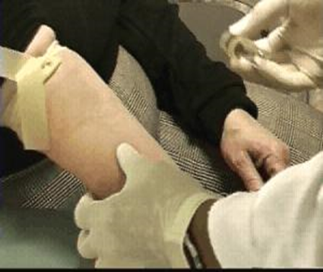
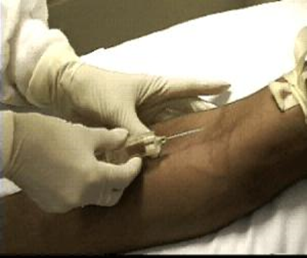
Specimen Collection
Proper Needle Insertion
1.Grasp the patient's arm/hand with the thumb on top and fingers wrapped to the back.
2. Pull the skin taut below the intended venipuncture site with the thumb, anchoring the vein to keep it from moving or rolling.
3. Using a smooth motion, quickly insert the needle, bevel up. Stop the needle advancement when a slight decrease in resistance is felt, signaling entry into the vein.

Slide 35
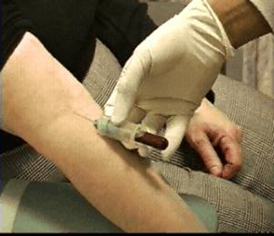
Specimen Collection
Filling Collection Tubes
Insert the collection tube into the port
Maintain the tube in a downward position so the blood and any tube additive it contains does not touch the needle.
Fill the tube until the vacuum is exhausted and/or adequate blood volume for the test.
Remove tube from the holder by applying pressure against the flanges of the tube holder with the thumb and index finger while using a slight twist to remove the tube. Hold the needle steady as tubes are removed and inserted.
If the tube contains an additive, invert it gently 8-10 times after removal to mix the blood and additive. Additional mixing can be performed while other tubes are filling.

Slide 36
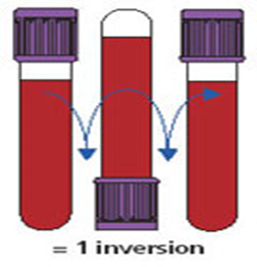
Specimen Collection
Sample Mixing
Proper technique: Inverting the Tubes
When: Immediately after drawing specimen
Why: Most tubes contain an additive to be mixed with the blood sample.
How: Holding tube upright, gently invert 180 degrees and back 5-10 times
Consequences if not mixed properly:
Blood can clot and specimen may need to be re-drawn or if too vigorous, hemolysis can occur.

Slide 37
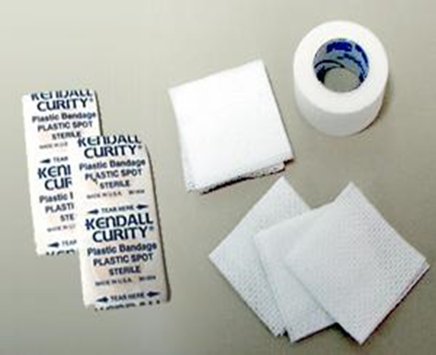



Specimen Collection
Post collection site care
Clean 2" x 2" gauze pads are used to place pressure over the venipuncture site once the needle is removed.
Do not remove gauze too soon. The clot that is forming may be disturbed and bleeding may restart
Us an adhesive bandage to cover the site once bleeding has ceased.
Use paper, cloth, or knitted tape over a folded gauze square for patients who are sensitive to adhesive bandages.

Slide 38
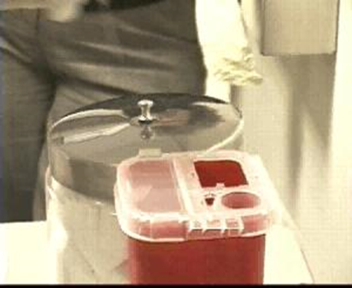
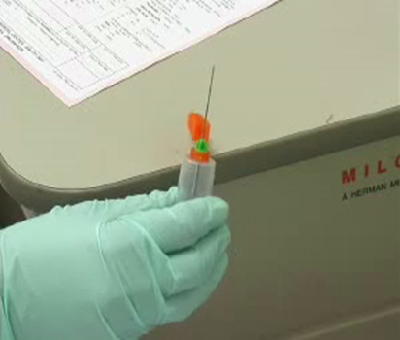
Specimen Collection
Proper disposal of sharps
NEVER CUT, BEND, BREAK OR RECAP NEEDLES !!!
As soon as the needle is removed from the patient, the safety device on the needle MUST be activated
Immediately discard ALL needles in a sharps container
needles should never be left on a syringe and sent to the lab

Slide 39
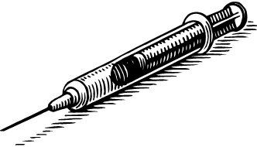
Specimen Collection
Avoid Needle Stick Injuries
Most Common Causes of Needle Stick Injuries:
#1 Safety Device not activated
Hand-off of needle device after use
Improper disposal
Manipulating the needle in the patient
Patient moves during the procedure
Safety Tips to Avoid Needle Stick Injuries:
Pre-plan for the disposal of the needle prior to the procedure
ALWAYS activate safety device on the needle
Work in good lighting
Immediately dispose of used needles
Do one thing at a time
Explain the procedure to the patient

Slide 40
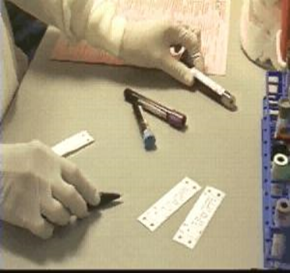
Specimen Collection
Sample Labeling
ALWAYS:
Verify the information on the tube labels match the information on the order slip and patient ID band.
Label tubes after they are drawn in the presence of the patient to reduce the risk of specimen misidentification.
If additional information must be added to the label (e.g., fasting, time of draw), write with ink, never pencil.
NEVER:
Label tubes prior to the venipuncture
Leave a patient room before labeling the tubes

Slide 41
Specimen Collection
Proper Specimen Identification
Unlabeled/Mislabeled blood or body fluid specimens will be rejected by Lab!
  Exception: “Precious body fluid”: Person obtaining specimen will need to complete reconciliation form.
Improperly labeled tubes will be rejected by Blood Bank – no exceptions!!!
Improperly labeled tubes in other lab areas might be processed:
  If problem can be resolved, and
  Reconciliation form is completed, and
  Approval by Lab Director or Manager
Note: Identification process requires you to come to the lab

Slide 42
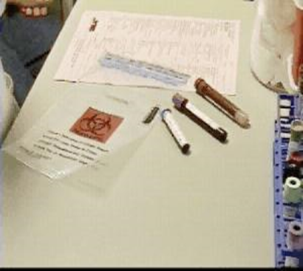
Specimen Collection
Sending the sample to Lab
Place labeled tube in a biohazardous specimen collection bag
Status specimen as “Collected” in Cerner, make sure the time of collection is accurate and print requisition.
NOTE: The time of collection will be the time the results post in Cerner.
To ensure accurate result times in the EMR NEVER status a specimen as “collected” until the specimen is in your hand.
Securely attach paper requisition in the pocket of the collection bag with the tube
Immediately transport the specimen to Lab via the Pneumatic Tube System

Slide 43
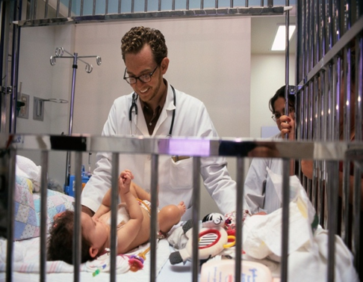
Specimen Collection
Pediatric patients
Blood volume is a critical factor in pediatric phlebotomy. Even a small amount of blood taken from a child can be a large percentage of the child's total blood volume.
Blood draws should be tracked in pediatric patients to avoid exceeding the amount of blood that can safely be taken.
Always use appropriate needle gauge size

Slide 44
Specimen Collection
OTHER BLOOD Collection TECHNIQUES

Slide 45
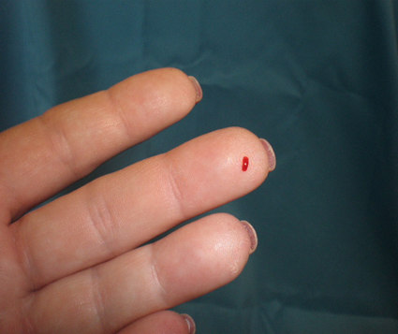
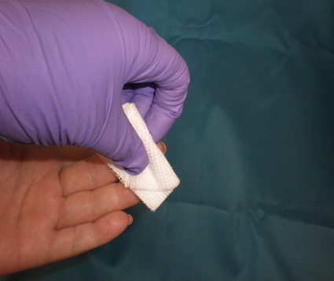
Finger Stick
Avoid fingers that are cold, cyanotic, swollen, scarred or covered with a rash. The 3 middle fingers are recommended.
Massage to warm the finger and increase blood flow by gently squeezing from hand to fingertip 5-6 times.
Cleanse fingertip with 70% isopropyl alcohol and allow to completely air dry.
Using a sterile retractable lancet, make a skin puncture just off the center of the finger pad.
ALWAYS Wipe away the first drop of blood with 2x2 (the 1st drop tends to contain excess tissue fluid which will impact the accuracy of the result).
NOTE: Do NOT squeeze or apply strong repetitive pressure to the site. This may result in hemolysis or increase tissue fluid in the blood causing invalid results.

Slide 46
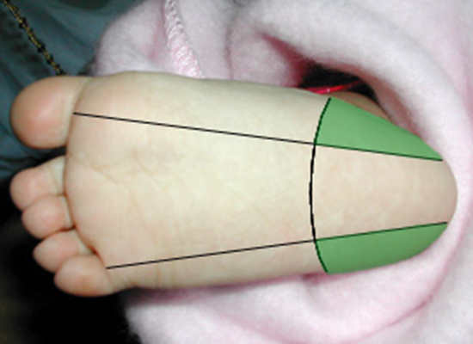
Heel Stick
LANCET NOT TO EXCEED 2.0 MM IN DEPTH
Pre-warming the site will increase the capillary blood flow, making the blood draw easier.
Cleanse site with alcohol, let air dry
Firmly but gently grip the foot or ankle, and pierce the skin with the retractable lancet
Wipe the first drop of blood away with 2x2.
To avoid puncturing bone, a heel puncture should only be performed in the recommended areas in Green (see diagram at left), and should not exceed 2.0 mm in depth

Slide 47
ARTERIAL BLOOD GAS
Site selection
The Radial Artery is the preferred puncture site for arterial puncture for adults and pediatrics.
Why?
  It is superficial- easy access
  Entry is easiest, minimizes pain
  Has collateral circulation (ulnar artery)
NOTE: Prior to collection, determine if your patient requires assessment of adequate collateral circulation based on their clinical history
Always document the collection site

Slide 48
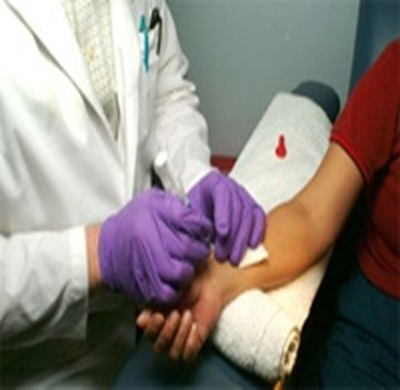
Arterial Blood Gas
Sample collection by authorized personnel ONLY
SUPPLIES: PPE ( face shield recommended), Blood gas syringe kit, 23g/21g needle, alcohol wipes, 2x2 gauze, tape.
Explain procedure to patient
Place a rolled washcloth under patient wrist for support and improved site access
Cleanse site, allow to air dry
Palpate the radial artery with index finger above insertion site
Hold syringe like a “pen” at a 45–90-degree angle with needle bevel UP and insert into artery
NOTE: When the artery is punctured you will note a flash of bright red blood in the hub of the needle
The blood should fill the syringe quickly
- Let the syringe fill by itself
When complete, remove the needle and immediately apply pressure to the site using the gauze

Slide 49
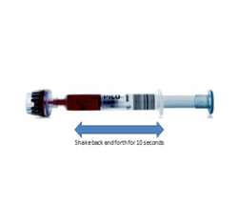
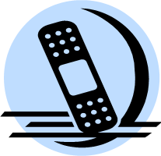
ARTERIAL BLOOD GAS
Post-Collection
Patient Care:
Raise/Elevate the affected extremity for 5-10 minutes, with pressure (4 x 4 gauze) applied to the puncture site.
Assess for bleeding/ hematoma formation at the puncture site.
If the patient is receiving blood thinners, pressure should be applied to puncture site for a minimum of 10 minutes.
Specimen:
Remove needle and cap tightly; leave no air space in syringe.
Shake Pico tube back and forth for 10 seconds
Label blood specimen In the patient’s presence
Place the specimen in a biohazard bag NO ICE.
Complete the requisition indicating time specimen was drawn, source
Place requisition in outside pocket of the biohazard bag.
The specimen must be sent to laboratory immediately, within 15 minutes.

Slide 50
Arterial Line Draws
Important considerations
1. Dilution:
During sampling from arterial catheters, there is a risk of diluting the sample with flush solution.
2. Consequence of removing insufficient flush solution:
NaCl solution will cause positive bias to Na+ and Cl–.
The bias affecting pO2 will depend on the actual patient pO2.
All other parameters will be negatively biased.
How to avoid these errors;
Check the specific catheter package for the exact volume of dead space
Discard at least 3 times the dead space when you are sampling from catheters
Draw the blood gas sample with a dedicated blood gas sampler –the PICO syringe- which contains dry electrolyte- balanced heparin
If in doubt of the quality of the sample, consider resampling

Slide 51
Blood Cultures
Special Considerations
Use of indwelling catheters:
Obtaining blood through indwelling lines should be discouraged
Rationale: Significantly increased risk of recovering skin organisms and access port contaminants if an intravascular catheter is used for collection
If a blood culture is collected through an intravenous catheter, a second blood culture should be collected by venipuncture at a properly decontaminated skin site for comparison
Short Draws:
If <10 mls of blood is collected from an adult, inoculate the aerobic bottle
If a second venipuncture also yields a short draw, inoculate another aerobic bottle
A third short draw may be placed in an aerobic or an anaerobic bottle
  REMEMBER: The important variable is the VOLUME of blood cultured
  Aerobic bottles generally have a higher yield of organisms than anaerobic bottles
  Most organisms recovered from blood cultures are facultative (can grow aerobically or anaerobically)

Slide 52

Blood Cultures
Proper Skin Antisepsis Procedure
First “vigorously” cleanse the site with 70% isopropyl alcohol using a back-and-forth motion for 30 seconds. This dislodges the bacterial cells from the deeper areas of the epidermis.
Apply chlorhexidine in a concentric circle “target” pattern and allow to air dry for 30 seconds to render contaminants non-viable.
Perform venipuncture

Slide 53
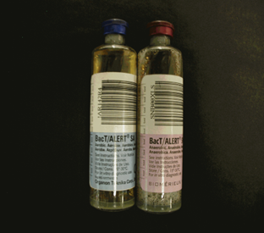
Blood Cultures
Sample size
The volume of blood is the single most important factor influencing the sensitivity of blood cultures
Maximum sensitivity for the culture is achieved when:
  Two cultures are drawn from SEPARATE venipuncture sites
  For each culture:
  10 ml is inoculated into the Aerobic bottle
  10 ml is inoculated into the Anaerobic bottle
  (Total of 20 ml per culture)
NEVER draw multiple blood culture samples from the same venipuncture site
NEVER use separate venipuncture sites for inoculating an aerobic and an anaerobic blood culture bottle. Each bottle must be inoculated from the same collection

Slide 54
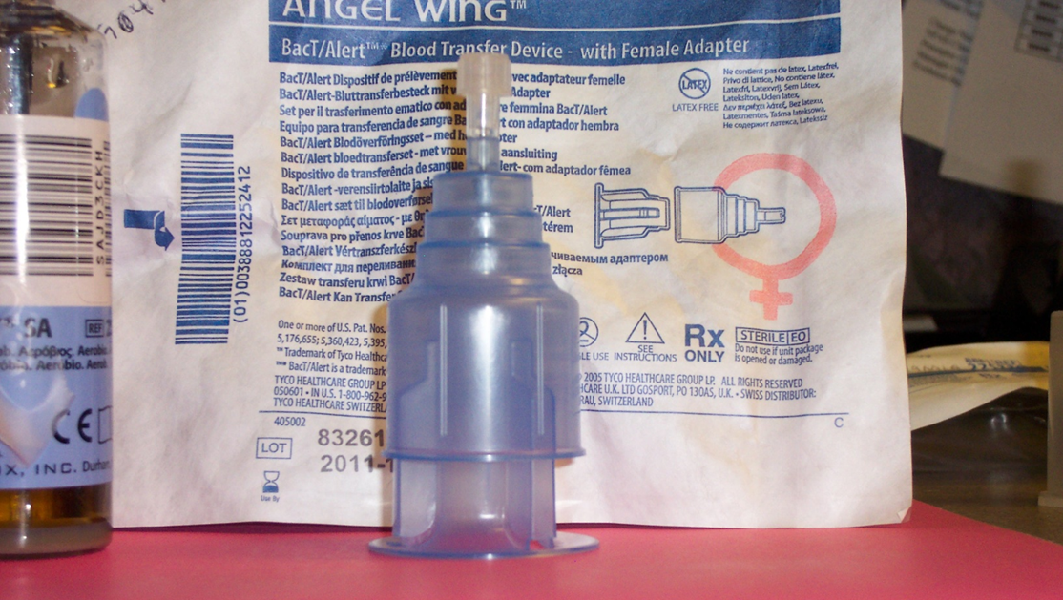

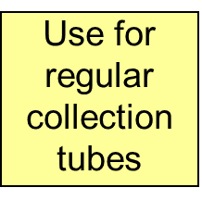
2 Piece Blood Collection Device
Dual Purpose:
For regular lab tubes and blood cultures

Slide 55
2- Piece Blood Collection Device
Angel Wing transfer device: Female adapter
For blood cultures and regular lab tubes

Slide 56
Blood Cultures
Special Considerations
Use of indwelling catheters:
Obtaining blood through indwelling lines should be discouraged
Significantly increased risk of recovering skin organisms and access port contaminants if an intravascular catheter is used for collection
If a blood culture is collected through an intravenous catheter, a second blood culture should be collected by venipuncture at a properly decontaminated skin site for comparison
Short Draws:
If <10 mls of blood is collected from an adult, inoculate the aerobic bottle
If a second venipuncture also yields a short draw, inoculate another aerobic bottle
A third short draw may be placed in an aerobic or an anaerobic bottle
  REMEMBER: The important variable is the VOLUME of blood cultured
  Aerobic bottles generally have a higher yield of organisms than anaerobic bottles
  Most organisms recovered from blood cultures are facultative (can grow aerobically or anaerobically)

Slide 57

Blood Cultures
Pediatric
Pediatric bottles are designed to accommodate up to 4 ml of blood
Level of bacteremia (the # of organisms/ml of blood) is usually greater in children than in adults
NEVER USE PEDIATRIC BLOOD CULTURE BOTTLES FOR ADULT SPECIMENS
Weight of patient (Kg) | Weight of patient (Lb) | Minimum volume per bottle
<1.0 | 2.2 | 1.0 ml
1.5-3.9 | 2.3-8.6 | 1.5 ml
4.0-13.9 | 8.7-30.6 | 3.0 ml

Slide 58
Next Steps to Ensure Compliance:
You have completed reviewing the content for the
“Blood Specimen Collection” course.
You must complete the Exam developed for this course.
Note: you may continue to review this course until you are confident about your knowledge of the content.

